Slide 1
The Cell Cycle & Cell Division

Slide 2
The Cell Cycle
http://www.nobel.se/medicine/laureates/2001/press.html

Slide 3
Animated Cycle
http://www.cellsalive.com/cell_cycle.htm

Slide 4
MITOSIS

Slide 5
Mitosis
The process of cell division which results in the production of two daughter cells from a single parent cell.
The daughter cells are identical to one another and to the original parent cell.

Slide 6
Mitosis can be divided into stages
Interphase
Prophase
Metaphase
Anaphase
Telophase & Cytokinesis

Slide 7
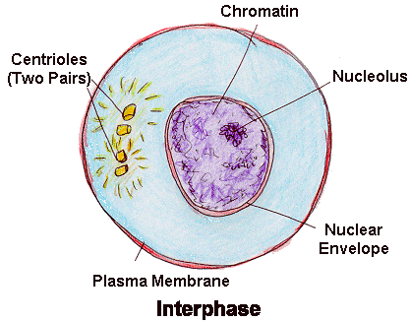
Interphase The cell prepares for division
Animal Cell & Plant Cell
DNA replicated
Organelles replicated
Cell increases in size
Cell grows and functions

Slide 8
Interphase
Animal Cell
Plant Cell
Photographs from: http://www.bioweb.uncc.edu/biol1110/Stages.htm

Slide 9
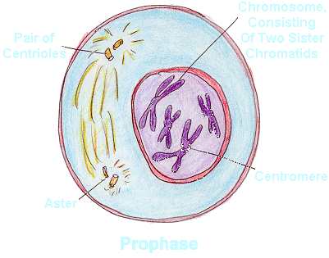
Prophase The cell prepares for nuclear division
Animal & Plant Cell
Packages DNA into chromosomes and become visible
Nuclear membrane dissolves

Slide 10
Prophase
Animal Cell
Plant Cell
Photographs from: http://www.bioweb.uncc.edu/biol1110/Stages.htm

Slide 11
Prophase
Fotosearch.com

Slide 12
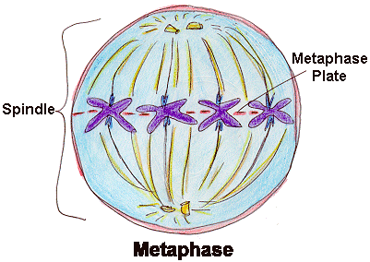
Metaphase The cell prepares chromosomes for division
Animal Cell & Plant Cell
Chromosomes line up at the center of the cell
Spindle fibers attach from centrioles to chromosomes at the centromere

Slide 13
Metaphase
Animal Cell
Plant Cell
Photographs from: http://www.bioweb.uncc.edu/biol1110/Stages.htm

Slide 14
Metaphase

Slide 15
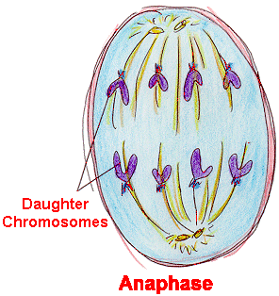
Anaphase The chromosomes divide
Animal Cell & Plant Cell
Spindle fibers pull chromosomes apart
½ of each chromosome (called chromatid) moves to opposite poles

Slide 16
Anaphase
Animal Cell
Plant Cell
Photographs from: http://www.bioweb.uncc.edu/biol1110/Stages.htm

Slide 17
Anaphase

Slide 18
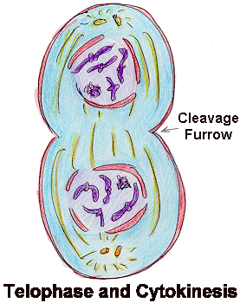
Telophase The cytoplasm divides
Animal Cell
DNA condenses
2 nuclei form
Cell membrane pinches in to form the 2 new daughter cells
Plant Cell
DNA condenses
2 nuclei form
New cell wall forms between the 2 nuclei to form the 2 new daughter cells

Slide 19
Telophase
Animal Cell
Plant Cell
Photographs from: http://www.bioweb.uncc.edu/biol1110/Stages.htm

Slide 20
Telophase and cytokinesis

Slide 21
Mitosis Animation
http://www.cellsalive.com/mitosis.htm

Slide 22
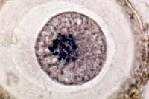
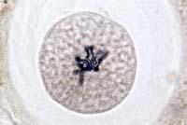
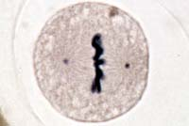
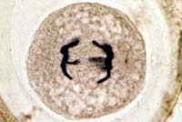
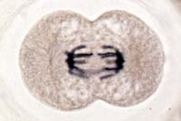
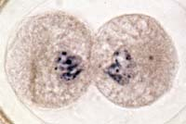
Animal Mitosis -- Review
Interphase | Prophase
Metaphase | Anaphase
Telophase | Interphase

Slide 23
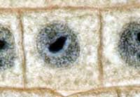
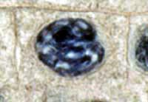
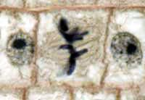
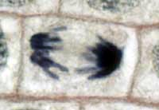
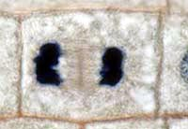
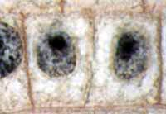
Plant Mitosis -- Review
Interphase | Prophase
Metaphase | Anaphase
Telophase | Interphase

