Slide 1
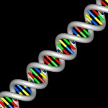
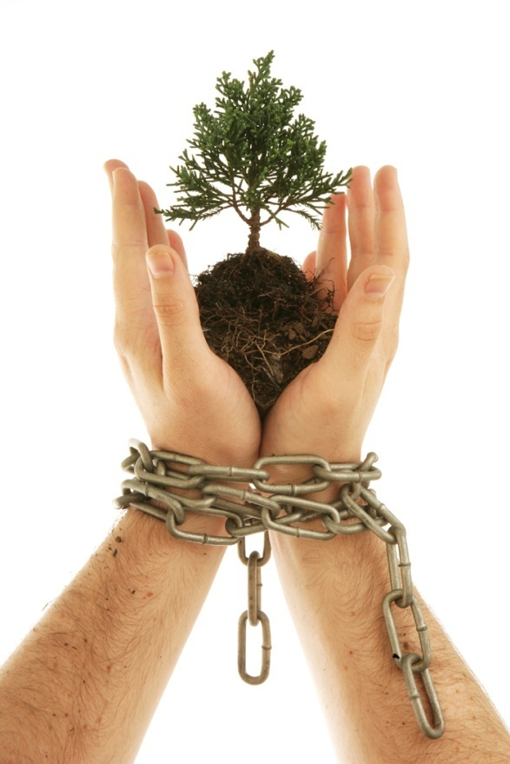
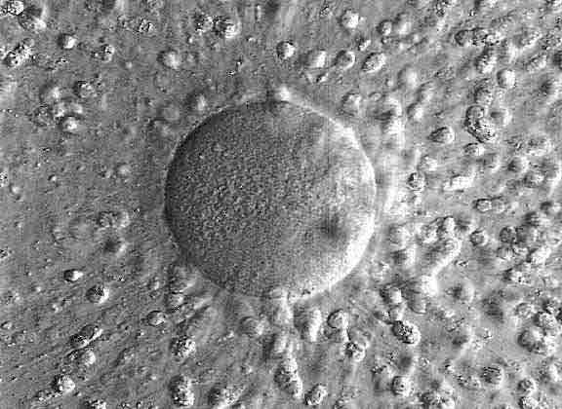
Characteristics of Life Quiz

Slide 2
1. The process in which 2 cells from different parents unite to produce the first cell of a new organism is called
Homeostasis
Development
Asexual reproduction
Sexual reproduction

Slide 3
2. The process by which organisms keep their internal conditions relatively stable is called
metabolism
A genome
evolution
homeostasis

Slide 4
3. Biology is
The study of animals only
The study of plants only
The study of life
The study of cells only

Slide 5
4. What is the biological process that includes chemical reactions that break down materials?
Metabolism
Homeostasis
Reproduction
Genetic code

Slide 6
5. True or false. Is this an example of a stimulus/response?
When an organism sees food, salivation automatically begins.

Slide 7
6. Which of the following does evolution help to explain?
How organisms reproduce
How organisms grow and develop
How organisms are related to each other
How organisms obtain and metabolize energy

Slide 8
7. Which of the following is the hereditary material in most living things?
DNA
Lipids
Oxygen
Carbon dioxide

Slide 9
8. Which of the following does the levels of organization within an organism describe?
Metabolism
Homeostasis
Internal structures
Relationship to the physical environment

Slide 10
9. All of the following are examples of characteristics of life EXCEPT
Growth
Reproduction
Movement
Use of energy

Slide 11
10. What is the term for a group of organisms of one type living in the same place?
Biosphere
Ecosystem
Population
Environment

Slide 12
You did a fantastic job!!!!
Let’s trade and grade

