Slide 1
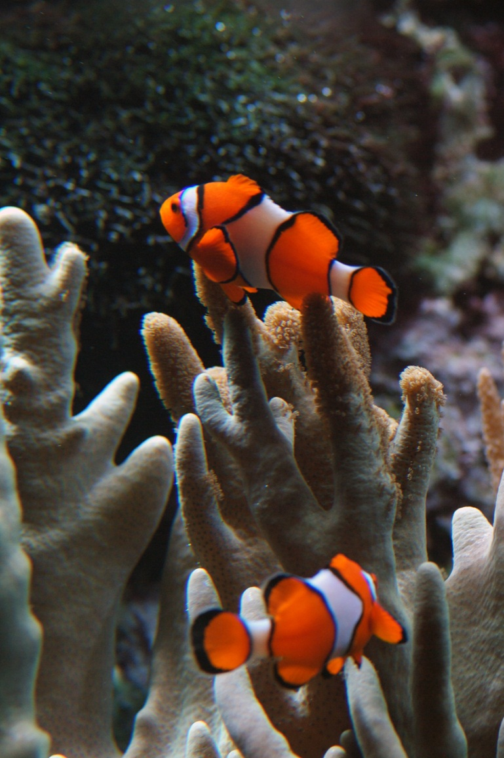
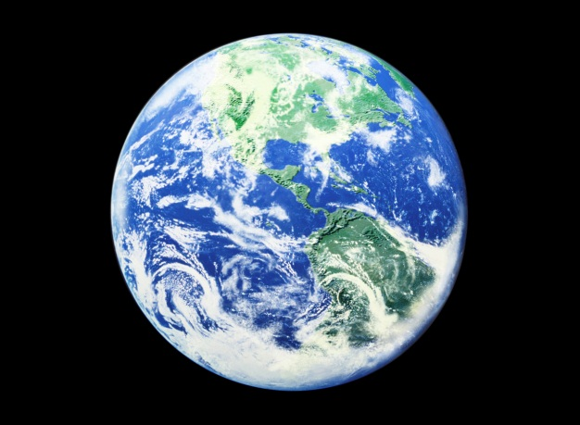
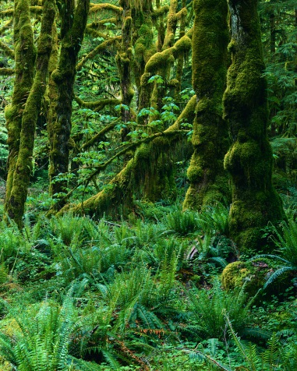
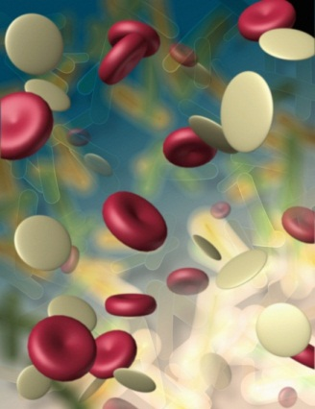
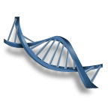
Introduction to Biology
Click “Nemo” for intro video
And the characteristics of life

Slide 2
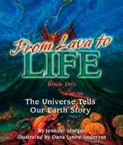
Biology – The Study of Life
Life arose more than 3.5 billion years ago
First organisms (living things) were single celled
Only life on Earth for millions of years
Organisms changed over time (evolved)
http://www.universestories.com/images/Lavacoverd-330.jpg

Slide 3
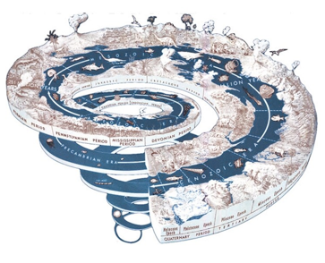
New organisms arose from older kinds
Today there are millions of species
They inhabit almost every region of Earth today
http://www.earth-life.org/earth-life/Appreciation/Entries/2010/1/28_Deep_time_files/shapeimage_10.png

Slide 4
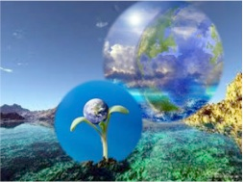
Themes of Biology
Cell structure and function
Stability and homeostasis
Reproduction and inheritance
Evolution
Interdependence of organisms
Matter, energy, and organization
http://ih.constantcontact.com/fs152/1101452006226/img/176.jpg

Slide 5
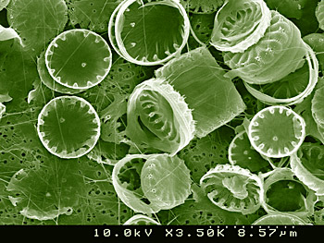
Cell Structure and Function
Cells are the basic unit of life
All organisms are made of and develop from cells
Some are single cell (unicellular) which is usually identical to parent
http://www.utexas.edu/features/graphics/2008/tree/tree1.jpg

Slide 6
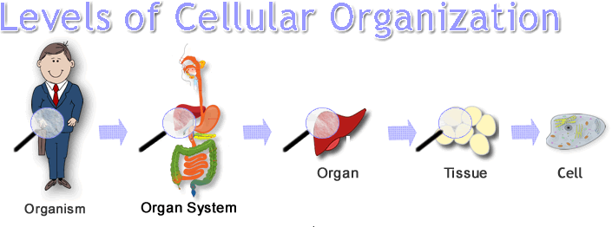
Most organisms are composed of many cells (multicellular)
Cells are different (undergo differentiation)
Cells are small
Cells are highly organized
http://edtech2.boisestate.edu/pattymcginnis/506/Images/Levels_of_cell_organization3.gif

Slide 7
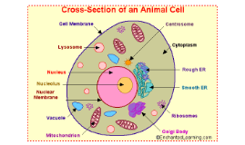
Cells contain specialized structures (organelles) that carry out the cell’s life processes
Many different kinds of cells exist
All cells surrounded by a plasma membrane
Contain a set of instructions called DNA (genetic information)
http://t2.gstatic.com/images?q=tbn:ANd9GcRxxjEQGw3R9zcSU9bJlYmuwPv6qdEY04EKbA0E3jHgNEFO2G6M5lF036Y:upload.wikimedia.org/wikipedia/commons/2/2b/DNA_structure_and_bases.svg
http://0901.static.prezi.com/preview/pradg3szpxdvj6m3cmzj776uy4adw6rhlm5vs2oll757hbaoaxlq_0_0.png

Slide 8
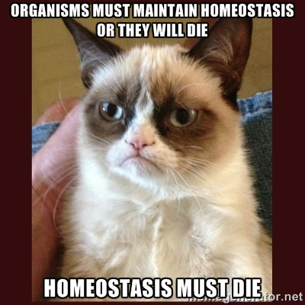
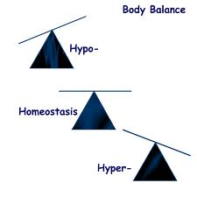
Stability and Homeostasis
Organisms must maintain very stable internal conditions - HOMEOSTASIS
Temperature, water content, chemical content, etc. must be maintained
http://iws.collin.edu/mweis/Images/Fireworks%20Drawings/2401%20related%20drawings/drawings%20in%20fireworks/body,%20cell,%20tissue/body_chem/drawing_homeostasis.png
http://cdn.memegenerator.net/instances/500x/44493262.jpg

Slide 9
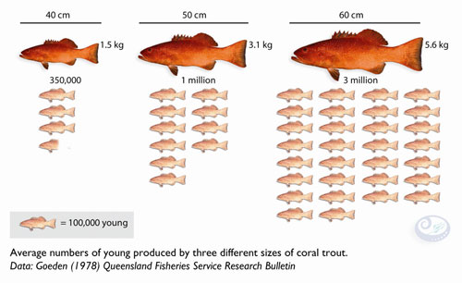
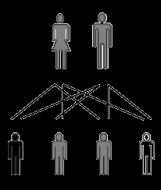
Reproduction and Inheritance
All organisms produce new organisms like themselves REPRODUCE
Organisms transmit hereditary information to their offspring INHERITANCE
http://www.protectplanetocean.org/images/successstories/coral_trout_reproduction.jpg
http://www.haemochromatosis.org.uk/images/genetic.gif

Slide 10
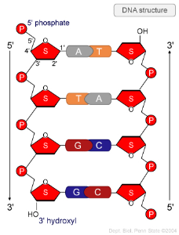
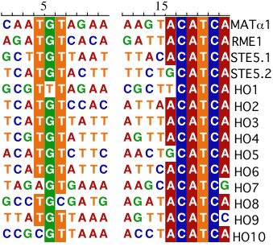
DNA
https://wikispaces.psu.edu/download/thumbnails/97552215/DNA_structure.jpg?version=1&modificationDate=1343315844000&api=v2
Genetic Information in all cells
Deoxyribonucleic Acid
DNA contains instructions for traits (GENES)
Make the structures and chemicals necessary for life…PROTEINS
DNA in every body cell (SOMATIC CELLS) is exactly alike
http://www.tulane.edu/~biochem/nolan/lectures/rna/images/homeoDNA.GIF

Slide 11
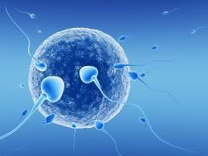
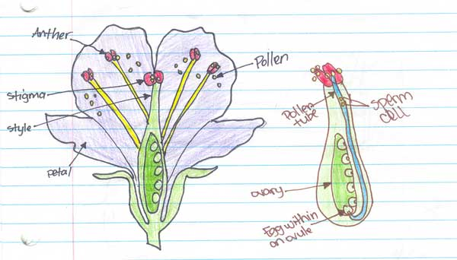
Sexual Reproduction
Hereditary information from two different organisms of the same species are combined
Egg and sperm → zygote (fertilized egg)
Zygote contains hereditary information from both parents
http://www.360living.in/sites/default/files/styles/article_listing_top_article_c_365_255/public/field/image/IVF.jpg
http://tedaltenberg.com/teacher/wms/science/unit4/images/pollination-vivian.jpg

Slide 12
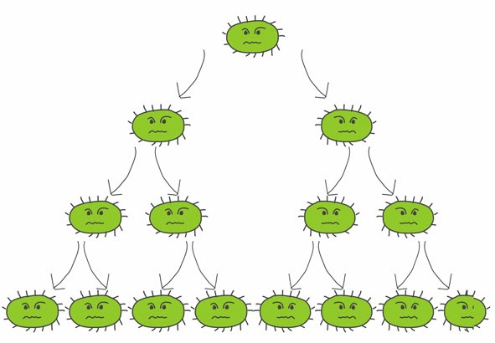
Asexual Reproduction
Hereditary information from one, usually unicellular, organism that divides
Resulting cells contain identical hereditary information
Genetic information from single parent
http://nat4biopl.edubuzz.org/_/rsrc/1384104941487/unit-2-multicellular-organisms/1-reproduction/AsexualReproduction.jpg

Slide 13
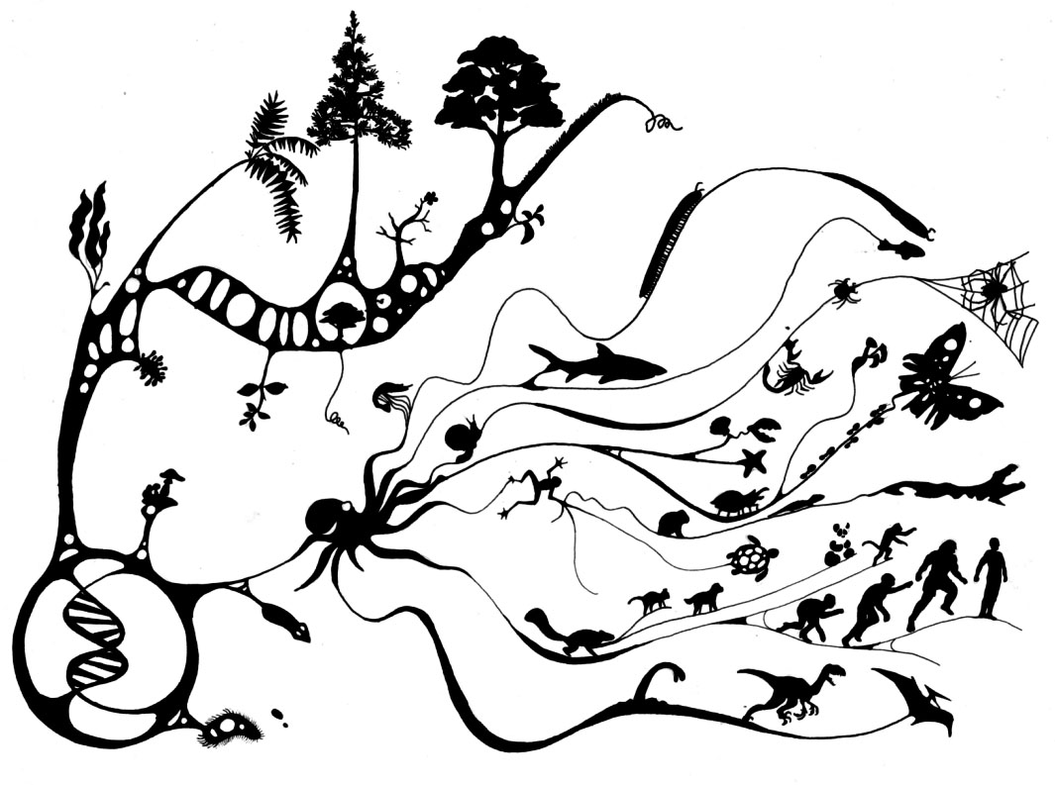
Evolution
Populations of organisms change (evolve) over generations (time)
Explains how many different kinds of organisms came into existence… SPECIES
Explains how modern organisms are related to past organisms
http://wondergressive.com/wp-content/uploads/2012/10/Evolution__Biologia.jpg

Slide 14
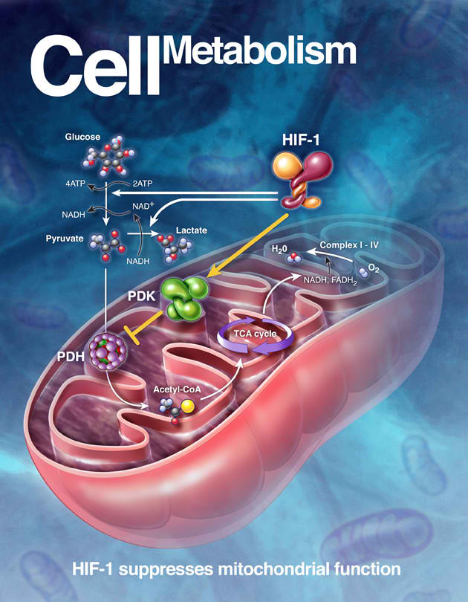
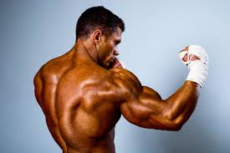
Metabolism
Living things are highly organized
Require a constant supply of energy
http://www.build-the-body.com/image-files/fast%20metabolism%20image.jpg
http://katedeering.com/wp-content/uploads/2012/06/CellMetabolismArt.jpg

Slide 15
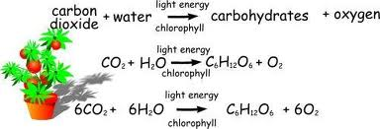
Energy
ALL energy comes from the SUN (directly or indirectly)
Photosynthesis is the process by which organisms capture the energy from the sun (solar) and transform it into energy (chemical) that can be used by living things
http://teachers.moed.bm/leone.samuels/Important%20Diagrams/_w/photosynthesis-equation_jpg.jpg

Slide 16
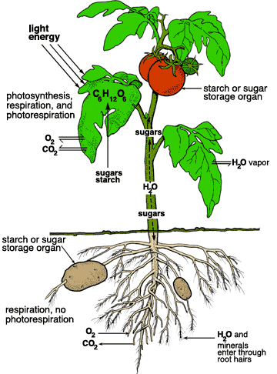
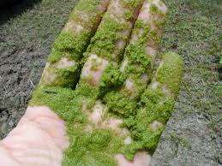
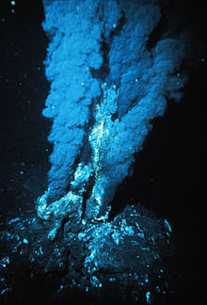
Autotrophs
Organisms that make their own food are called autotrophs
Phototrophs – use solar energy (photosynthesis) to get energy
Chemotrophs – use different chemicals to get energy
http://www.biologyjunction.com/images/penergy.gif
http://wpcontent.answcdn.com/wikipedia/commons/thumb/6/6f/Blacksmoker_in_Atlantic_Ocean.jpg/220px-Blacksmoker_in_Atlantic_Ocean.jpg
http://t3.gstatic.com/images?q=tbn:ANd9GcSTh-L0jlJvvPOiEI27EWeBWpqXTKGs3BKa3_igzetNLA2XiOUs:1.bp.blogspot.com/_ArZeHyQkL6M/S6tCc_bcO-I/AAAAAAAAAHs/NVovovn0z4M/s1600/algae-1.jpg

Slide 17
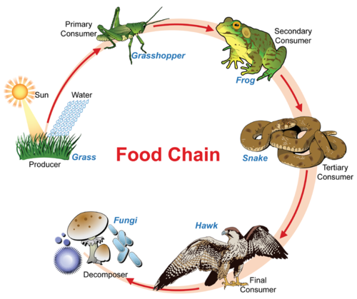
Heterotrophs
Organisms that must take in food to meet their energy needs
Consume autotrophs (herbivores), other heterotrophs (carnivores) or both (omnivores) for their energy needs
https://dr282zn36sxxg.cloudfront.net/datastreams/f-d%3Acb8bc0580f7952696772226ddb025c25141dda741422875a3c6a3ed9%2BIMAGE_THUMB_POSTCARD%2BIMAGE_THUMB_POSTCARD.1

Slide 18
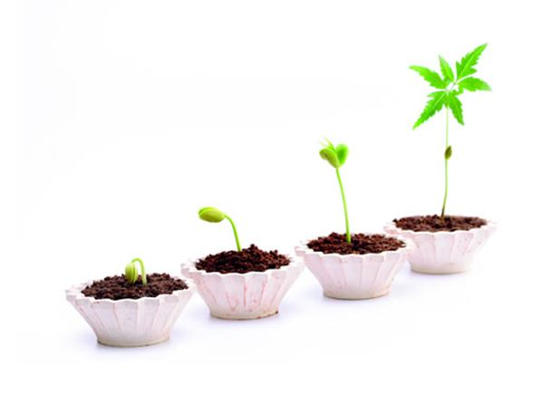
Growth
Grow occurs as the result of cell division and cell enlargement
New cells enlarge as they mature
When a cell grows to a size where its surface area isn’t big enough for its volume, the cell divides
http://www.carbontrust.com/ImageGen.ashx?image=/media/24882/green-growth.jpg&format=jpg&compression=80&width=588&constrain=true

Slide 19
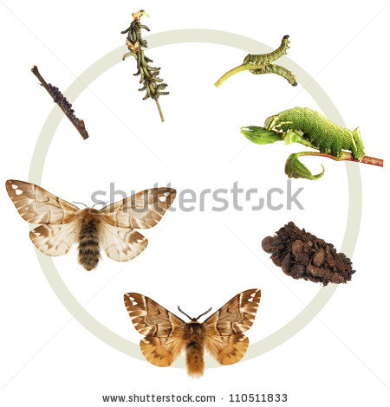
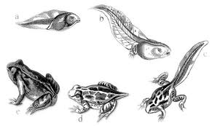
Development
The process by which an adult organism arise is called development
http://t2.gstatic.com/images?q=tbn:ANd9GcRMF6ABIOf7-hlJDdEs7xJ1-9hn3Kh1e_0hHa5UZSAg2cih6DlnIQ:www.wpclipart.com/animals/F/frogs/frogs_2/frog_metamorphosis.png
http://thumb10.shutterstock.com/display_pic_with_logo/88729/110511833/stock-photo-the-life-cycle-of-the-kentish-glory-endromis-versicolor-metamorphosis-showing-all-instars-egg-110511833.jpg

Slide 20
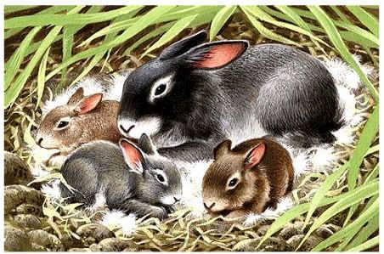
Reproduction
All species have the ability to reproduce
Not essential to survival of individual but is essential for continuation of a species

Slide 21
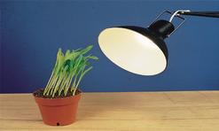
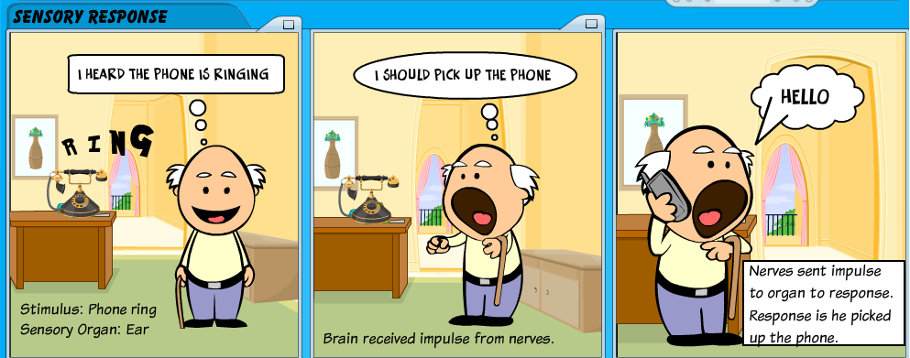
Response to stimuli
http://adaptations-of-organisms.wikispaces.com/file/view/light.jpg/173644489/247x148/light.jpg
Detect and respond to changes in light, heat, sound and chemical and mechanical contact
http://3.bp.blogspot.com/-MB2Y9dIdEXk/UL3UOLQMKlI/AAAAAAAAAA8/jsXiCyZ2tWs/s1600/sensory+response.png

Slide 22
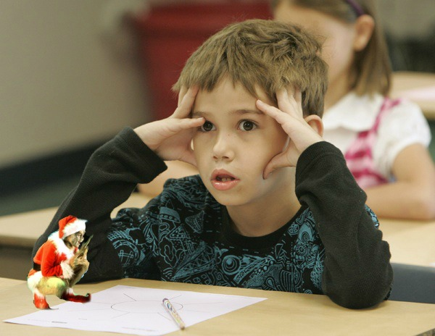
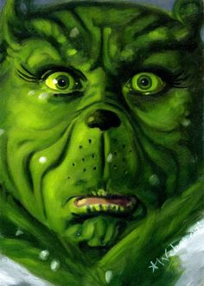
feel like this???
Try this.....
http://catsconnect.files.wordpress.com/2013/12/confused.jpg
Mr. grech
http://media-cache-ak0.pinimg.com/236x/38/ec/b3/38ecb35493d48c921f48a2447dd6ef51.jpg

Slide 24
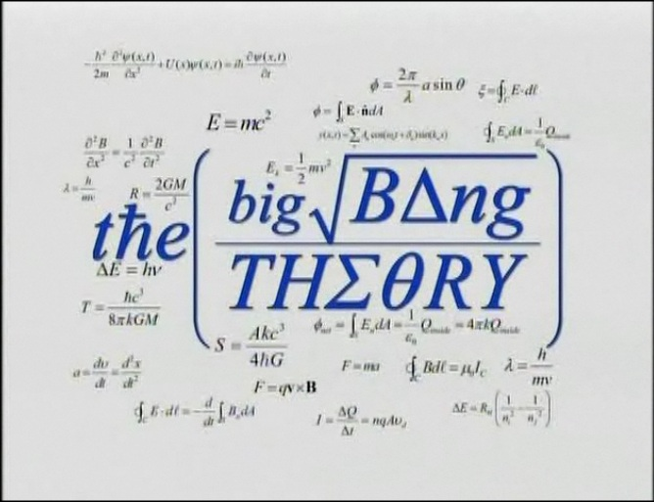
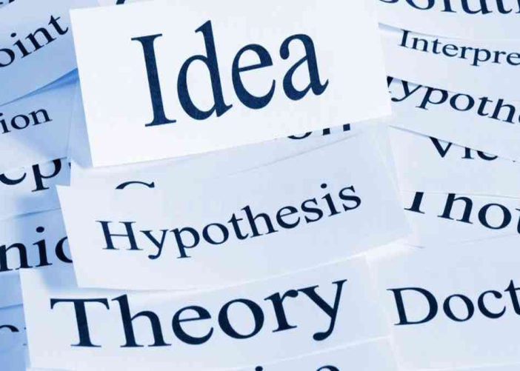
Theory
A broad and comprehensive statement supported by considerable evidence and ties together related hypotheses
http://img1.wikia.nocookie.net/__cb20121004051416/bigbangtheory/images/f/fd/Original_The_Big_Bang_Theory_title.jpeg
http://www.greenbookblog.org/wp-content/uploads/2013/11/theory.jpg

Slide 25
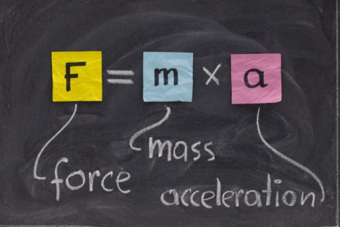
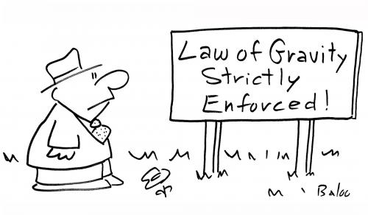
Law
A Statement of fact Accepted to be true
Universal
May be expressed as a math equation e.g. E=mc²
http://s.hswstatic.com/gif/scientific-law-quiz-orig-622x415-1.jpg
http://www.fromquarkstoquasars.com/wp-content/uploads/2013/08/law-of-gravity-enforced.jpg

