Slide 1
Meiosis
Making Reproductive Cells

Slide 2
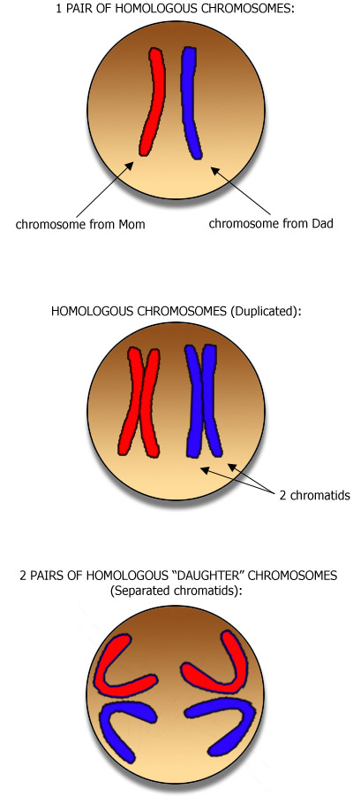
Chromosomes
Homologous Chromosome: The two chromosomes of a matching pair
Notes:
Homologous Chromosome: The two chromosomes of a matching pair. The members of most homologous pairs of chromosomes look alike. They are the same length, their centromeres are in the same position, they show the same pattern of light and dark bands when stained, and they carry genes for the same inherited characteristics, line up on the chromosome in the same order.

Slide 3
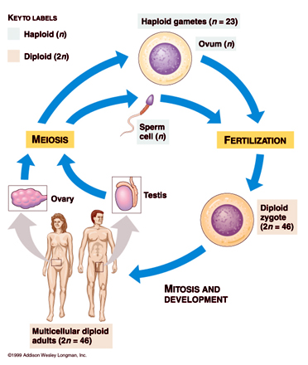
The Human Life Cycle
Notes:
Haploid: pertaining to a single set of unpaired chromosomes or an organism or cell that comprises of a single set of chromosomes (Biology) Diploid: Contain two homologus sets of chromosomes
Gonads: An organ in animals that produces gametes, especially a testis or ovary.
Gametes: reproductive cells or sex cells
Zygote the fertilized egg (when you add two gametes together)

Slide 4
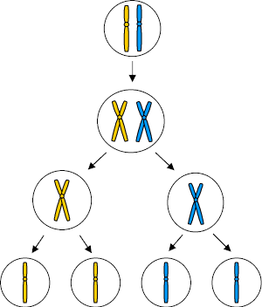
Meiosis
Produce 4 haploid gametes through
Interphase – replication of DNA
Meiosis I – separation of homologous chromosomes
(in 4-5 steps: prophase I, metaphase I, anaphase I, and telophase I and cytokinesis I)
Meiosis II – separation of sister chromatids
(prophase II, metaphase II, anaphase II, telophase II and cytokinesis II)
Only occurs in gonads

Slide 5
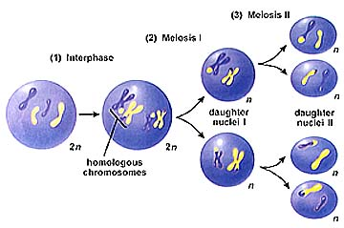
MEIOSIS

Slide 6
Interphase
Growth and sythesis of DNA (and copy organelles)
Same as mitosis

Slide 7
Meiosis I
division of nucleus (and cell) to form 2 haploid cells by splitting homologous pairs

Slide 8
Prophase I
Synapsis – pairing of the homologous chromosomes
Tetrad – homologous pair

Slide 9
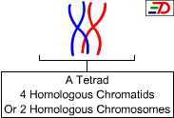
Prophase I
The homologous pairs meet and join together to form a tetrad (four chromatids all together)
This process is called synapsis

Slide 10
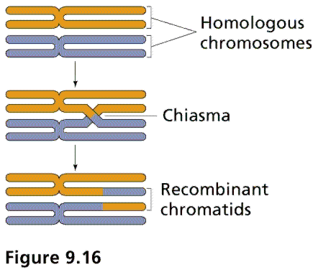
Crossing over
While a tetrad is present, crossing over occurs
Which involves the genes of one chromatid are exchanged for the genes of another.
This gives rise to genetic variability.
exchange

Slide 11
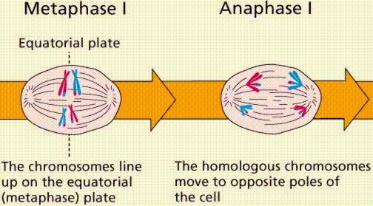
pairs line up in middle
Homologous pairs split

Slide 12
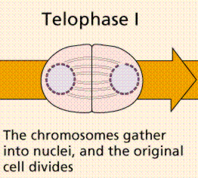

Slide 13
Meiosis II
Now the chromosome number has been reduced to haploid from diploid
The function of the second phase of meiosis is to separate the chromosomes into four chromatids to produce four genetically unique gametes
(this is the same as mitosis except starting with two cells with only half the chromosomes and resulting in 4 unique haploid cells)

Slide 14
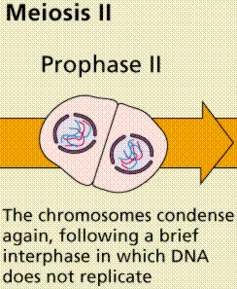

Slide 15
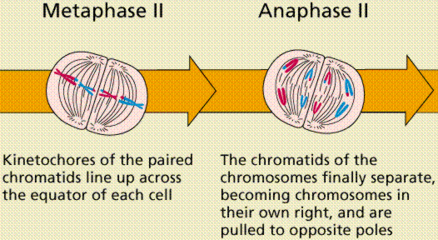

Slide 16
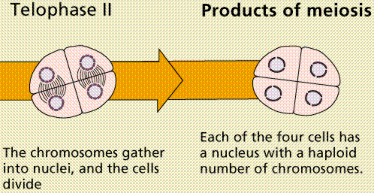

Slide 17
http://www.tokyo-med.ac.jp/genet/mfi-e.htm
http://www.tokyo-med.ac.jp/genet/mfi-e.htm

Slide 18
Nondisjunction

Slide 19
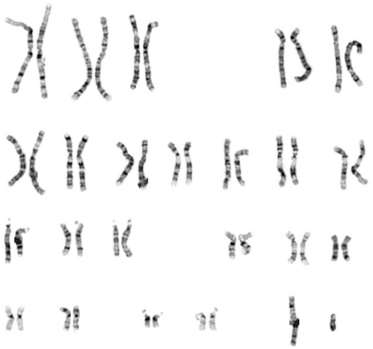
Karyotype

Slide 20
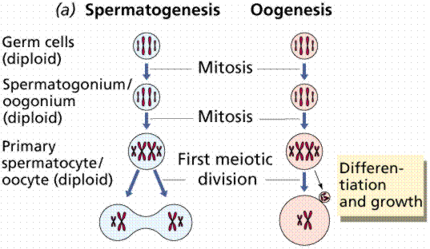
Gametogenesis

Slide 21
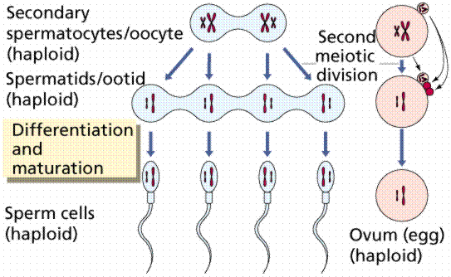
Gametogenesis

Slide 22
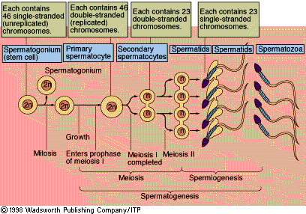
Spermatogenesis & Oogenesis

Slide 23
Sperm Meiosis

Slide 24
Oocyte

Slide 25
End results of gametogenesis
The divisions that create gametes result in 4 spermatids in the male and 1 egg in the female.
There can be as many as 3 polar bodies that also form in the female. They are small and have sacrificed their cytoplasm and organelles for the good of the one large egg.

Slide 26
Twins

Slide 27
Sex determination
The sex of a child is always determined by the sperm of the father. Any presence of a Y chromosome makes the person a male.
The mother’s eggs always carry an X chromosome.
If the sperm that fertilizes the egg carries an X chromosome, the child will be a girl and if it carries a Y chromosome the child will be a boy.
Girl=XX
Boy=XY

Slide 28
Mutations
There are many types of mutations that can occur in DNA.
If the mutation involves one or only a few base pairs (only one gene), it is called a point mutation.
Substitution-effects only one amino acid
Frame shift-can effect the entire protein

Slide 29
GENETICS

Slide 30
Chromosomal mutations
Duplication occurs when a piece of a chromosome is duplicated and becomes too long.
Deletion occurs when a piece of chromosome is entirely lost or broken off.
Inversion occurs when a chromosome piece breaks off and is reinserted in reverse orientation.
Translocation occurs when a piece of a chromosome breaks off and is attached to a different chromosome.
Nondisjunction occurs when an entire chromosome fails to separate in meiosis. One gamete will receive an extra chromosome and the other will lack the chromosome entirely.

Slide 31
Nondisjunction

Slide 32
Chromosome mutations

Slide 33
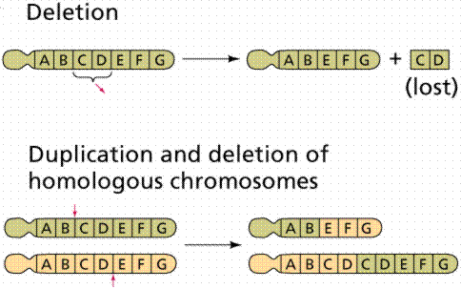

Slide 34
