Slide 1
Biology 1: Ms Duncan
Photosynthesis: An Overview

Slide 2
Vocabulary (KIM chart)
Chloroplast
Thylakoid
Granum
Stroma
Pigment
Chlorophyll
Glucose
Oxygen
Carbohydrates

Slide 3
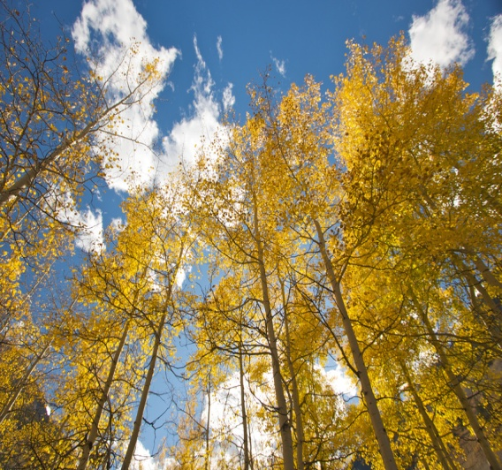
Photosynthesis Equation
carbon dioxide + water glucose+ oxygen
Light

Slide 4
Photosynthesis Equation
6CO₂+ 6H₂O C₆H₁₂O₆ + 6O₂
Light

Slide 5
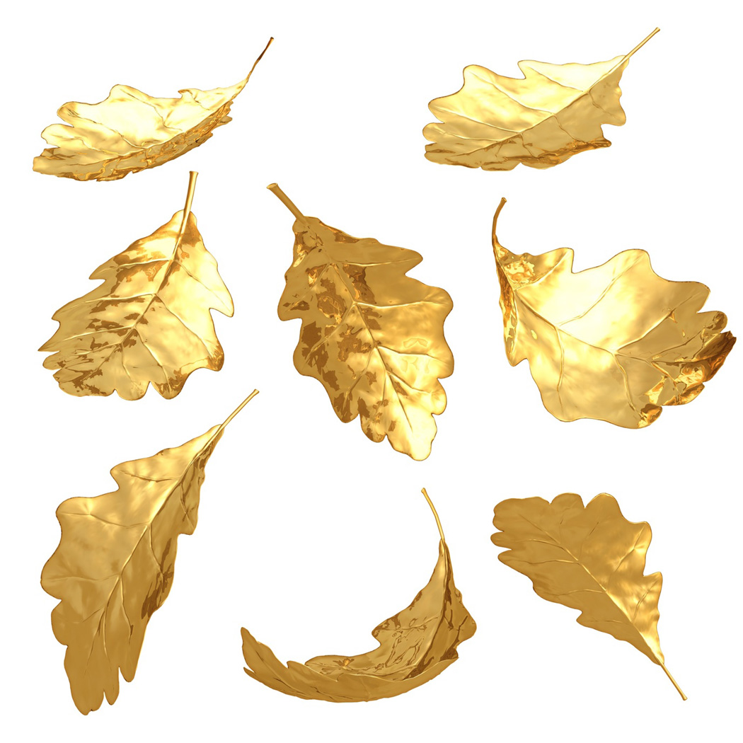
How do we know?!

Slide 6
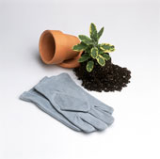
Jan Van Helmont
1600’s

Slide 7
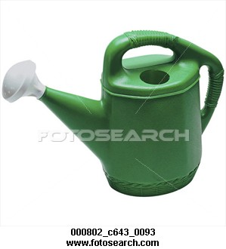
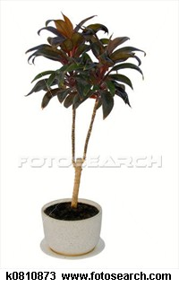
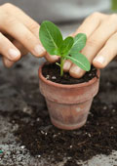
Jan Van Helmont
1600’s
Measures soil at planting time
Measures soil again after growth
Waters the plant

Slide 8
Jan Van Helmont
1600’s
No change in soil mass!!!!

Slide 9
Jan Van Helmont
1600’s
The water contributed to the mass of the plant…not the soil!!!!

Slide 10
Jan Van Helmont
1600’s
Contribution to science?
The “hydrate” portion of carbo - ”hydrate”

Slide 11
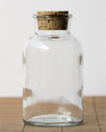
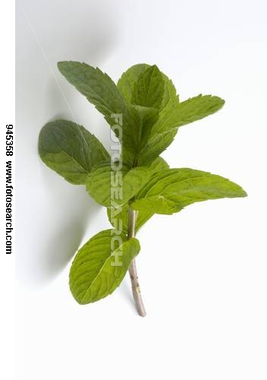
Click!
Joseph Priestly
1771
Contribution to photosynthesis?
Plants produce oxygen
Sprig of mint for a few days
Candle burned longer

Slide 12
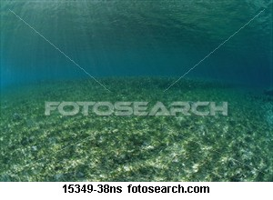
Jan Ingenhousz 1779
Plants only produce oxygen in the presence of light.
NO oxygen bubbles
oxygen bubbles

Slide 13
Light
6CO₂+ 6H₂O C₆H₁₂O₆ + 6O₂
The experiments performed by van Helmont, Priestley, and Ingenhousz led to work by other scientists who finally discovered that, in the presence of light, plants transform carbon dioxide and water into carbohydrates, and they also release oxygen.

Slide 14
The Role of Pigments and Light
In addition to CO₂ and H₂O, plants need chlorophyll and light
Light is a form of energy, so any compound that absorbs light also absorbs energy from that light.
The molecule that absorbs light in a plant is chlorophyll

Slide 15
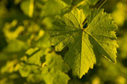
Chlorophyll
Chlorophyll absorbs all light, EXCEPT green, which is why a plant looks green
This energy is transferred to electrons, which power photosynthesis

Slide 16
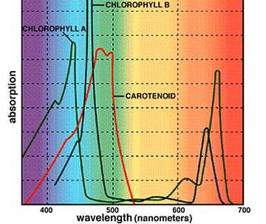
Chlorophyll – wavelength absorption
Chlorophyll α
Chlorophyll B
Carotenoids – another plant pigment, absorbs green

