Slide 1
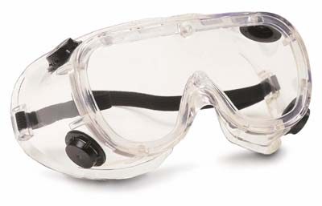
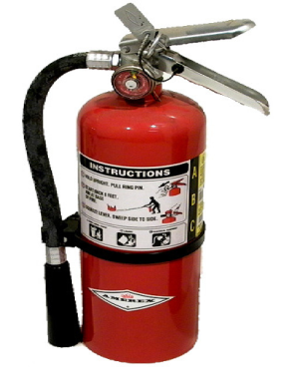
Lab Safety Skills
Stacy Duncan
Palm Harbor University High School
Notes:
Click on titles and icons to show neat and fun lab safety music videos as your students are entering the classroom

Slide 2
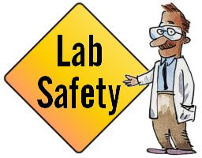
Objectives
Identify the basic safety equipment needed for all science classrooms.
Locate safety equipment in the classroom.
Follow safety guidelines set by the teacher.
Identify safety rules that have been broken.

Slide 3
Activity 1: Activate Prior Knowledge
Page 1 of Interactive Science Notebook
Spider Map
Fire
Behavior
Lab Safety
Glassware
First Aid
Notes:
Students copy concept map into interactive notebook.
Model process of thinking and filling in the map to students
Individual (allow 3 – 5 minutes)
Pair/Share (2-3 minutes)
Class share and teacher copies student responses into this map

Slide 4
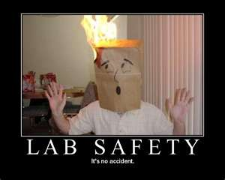
Activity 2: Safety Video
As you watch the video, write down what violations you observe
Click for video
Notes:
I will give each student a post-it note, or they can use a ½ sheet of paper to jot down lab safety rules that have been broken.
STOP – at around 3:30 min, discuss some of the students observations, then have students check their answers by finishing the video.

Slide 5
Activity 3: Familiarize with Safety Equipment and Classroom Placement
Cut and paste classroom layout on page 2.
Cut out icons of safety equipment.
As you peruse the classroom, paste the safety equipment in the area of the classroom layout where you found the equipment.

Slide 6
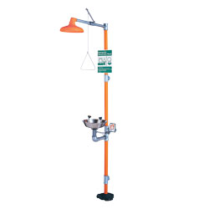
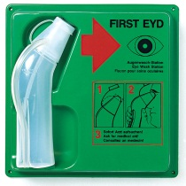
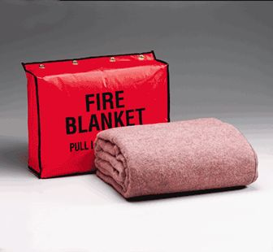
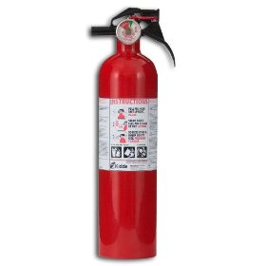
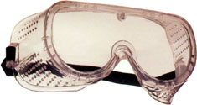
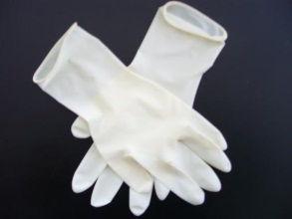
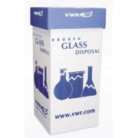
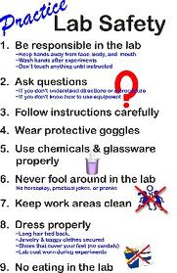
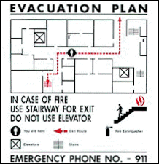
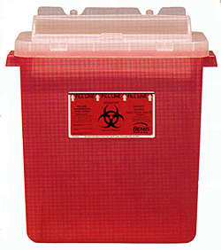
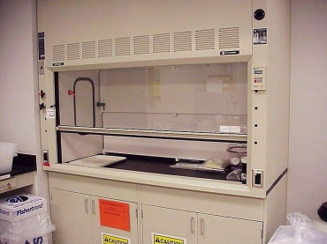
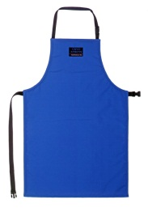
Fire Extinguisher
Shower
Eye Wash
Fire Blanket
Goggles
Gloves
First Aid Kit
Safety Rules
Glass Disposal
Sharp’s Container
Fume Hood
Aprons

Slide 7
Back Door
Teacher’s Desk
Front of Classroom
Back of Classroom
Entry

Slide 8
Activity 4: Bikini Bottom Safety
Part 1:
Cut and paste booklet on page 4
Read and highlight safety infraction
Part 2:
Write “Lab Safety Rules!” on page 3 and for each letter come up with a word that relates to lab safety (example on next slide)
Click SpongeBob for a link to the activity print out

Slide 9
L
A
B
S
A
F
E
T
Y
Rules!!!
Why is Lab Safety Important?
Students will complete a QuickWrite in this part
Notes:
After the SpongeBob Activity, have students do a pair/share activity in which they come up with a rule for each of the letters in “LAB SAFETY.”
Next, have students share their ideas on the why lab safety is important in the classroom. Give them about 3-4 minutes to share.
Finally, have the students do a “quickwrite” on the bottom half of the paper on the subject.

Slide 10
Activity 5: Safety Scenarios
Click for scenarios
Distribute your Lab Safety Rules. Cut and paste on page 6
Each student will be given 2 scenarios. Cut and paste on page 5. Leave room between each scenario to create a list of safety rules broken
Each group with the same scenarios will group together and decide which rules were broken, and list those rules under the scenario.
Notes:
When you have passed out the rules, give the students about 5 – 10 minutes to silently read through the rules. I will give the students a “challenge” question to answer while reading. (This gives them a purpose) For example, “What rule or rules did you read that you have never heard before?”
Then, get them into their scenario groups for the activity.

Slide 11
Activity 6: Science Safety Quiz
You must pass with a 90% or better!!
Good Luck!
Click for sample quiz

