Slide 1
CHAPTER 2
CHEMISTRY AND BIOCHEMISTRY

Slide 2
Chapter 2 Chemical Principles
Structure of Atoms
Chemistry is the science dealing with the properties & the transformations (chemical reactions) of all forms of matter
Matter is ….anything that takes up space or has mass.
Matter is made of elements.

Slide 3
Chapter 2 Chemical Principles

Slide 4
Chapter 2 Chemical Principles
Structure of Atoms
Atoms contain protons, neutrons, and electrons.
Protons - positive charge – 1 atomic mass unit
Neutrons – no charge – 1 atomic mass unit
Electrons – negative charge – almost no mass

Slide 5
Chapter 2 Chemical Principles

Slide 6
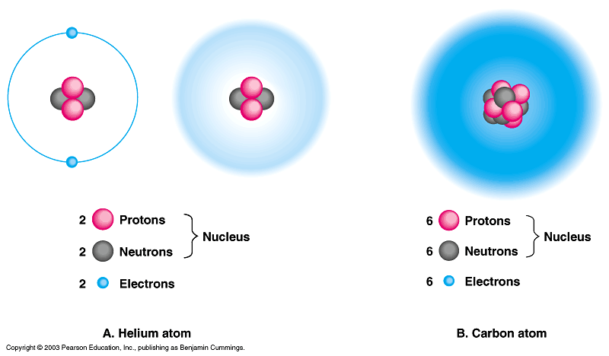
Chapter 2 Chemical Principles
Structure of Atoms

Slide 7
Chapter 2 Chemical Principles
Structure of Atoms
Atomic Number = number of protons In atom
Atomic Mass = mass of protons, neutrons and electrons in atom

Slide 8
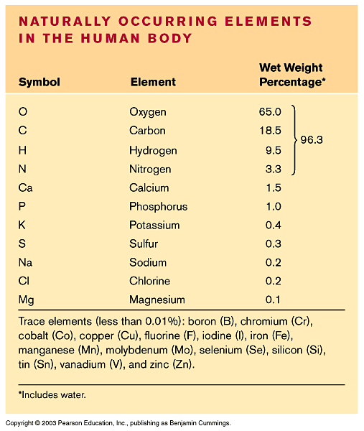
Chapter 2 Chemical Principles
Structure of Atoms
C
H
N
O
P
S

Slide 9
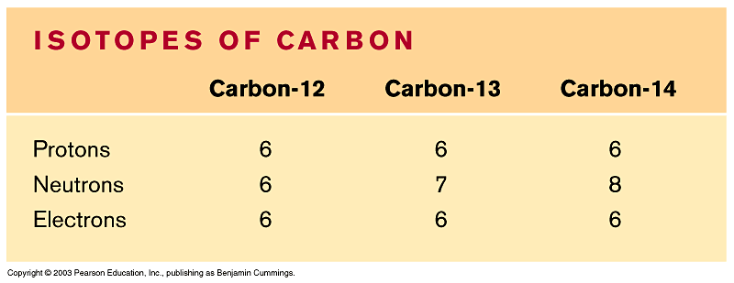
Chapter 2 Chemical Principles
Structure of Atoms
Isotopes – alternative forms of an atom that differ in their number of neutrons
How are these atoms different from each other?
What can isotopes be used for?

Slide 10
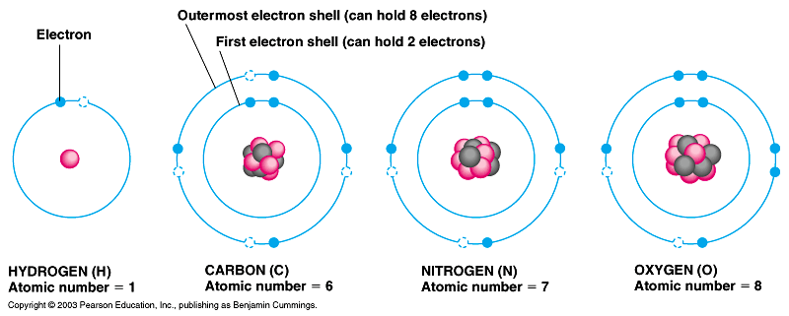
Chapter 2 Chemical Principles
Structure of Atoms
There are certain spaces around the nucleus where electrons are likely to be found. The electron is found a certain distance from the nucleus called a shell. Within a shell is an orbital that holds 2 electrons.

Slide 11
Chapter 2 Chemical Principles
Structure of Atoms
The outermost electron shell is referred to as the valence shell.

Slide 12
Chapter 2 Chemical Principles
Structure of Atoms
RULES
ABOUT
ELECTRONS!
1. First energy shell can contain a maximum of 2 electrons
2. All other shells can contain a maximum of 8 electrons (there are exceptions)
An atom is most stable when the valence shell contains a full 8 electrons = OCTET RULE

Slide 13
Chapter 2 Chemical Principles
Structure of Atoms
RULES
ABOUT
ELECTRONS!
Electrons determine chemical reactivity.
Atoms are reactive unless they have a full valence shell of electrons!

Slide 14
Chapter 2 Chemical Principles
Structure of Atoms

Slide 15
Chapter 2 Chemical Principles
Structure of Atoms
Which atoms on the periodic table have a full valence shell?
Which atoms on the periodic table have only one electron in the valence shell?
Which atoms on the periodic table have seven electrons in the valence shell?

Slide 16
Chapter 2 Chemical Principles
Bonding
BONDING
IONIC BONDING COVALENT BONDING
non-polar covalent
and
polar covalent

Slide 17
Chapter 2 Chemical Principles
Bonding
Ionic bonding – Atoms transfer or accept electrons from one another
Look at the following diagram with regards to sodium (Na) and chloride (Cl)
What must each do to fulfill the octet rule?

Slide 18
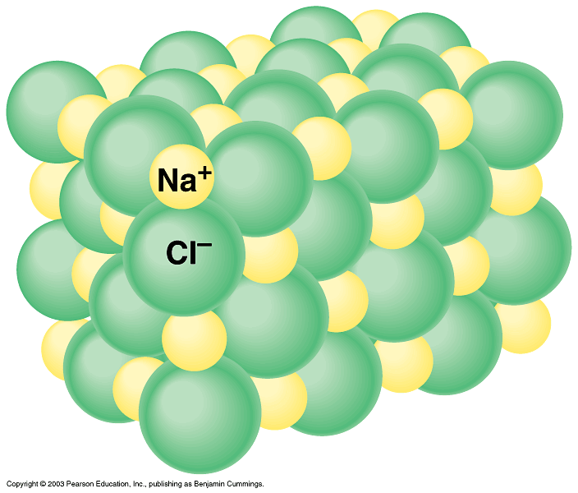
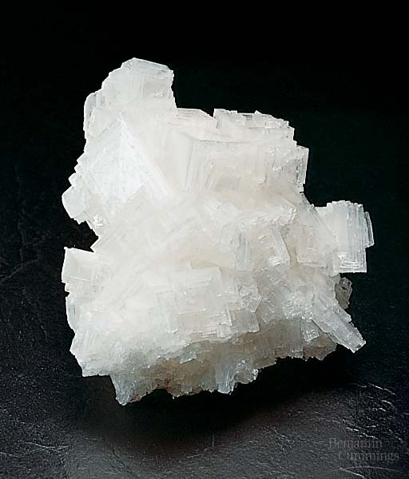
Chapter 2 Chemical Principles
Bonding
Ionic bonding
The sodium ion and the chloride ion will be attracted to each other and form an ionic bond.
Na ⁺
Cl ⁻
The ionic bond is due to the attractive forces between the now positively charged sodium & the negatively charged chloride.
By looking at the periodic table, can you predict which atoms may form ionic bonds?

Slide 19
Chapter 2 Chemical Principles
Bonding
Covalent bonding
Non-polar covalent bond – equal sharing of electrons
Polar covalent bond – unequal sharing of electrons
What does the word polar mean?

Slide 20
Chapter 2 Chemical Principles
Bonding
Covalent bonding
C
H
How many electrons are needed to fill the valence shell of carbon?
How many electrons are needed to fill the valence shell of hydrogen?
In the molecule of methane (CH₄), the electrons are shared equally between the carbon and hydrogens.

Slide 21
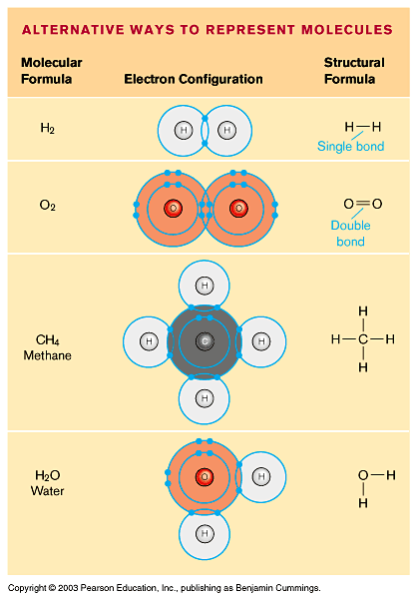
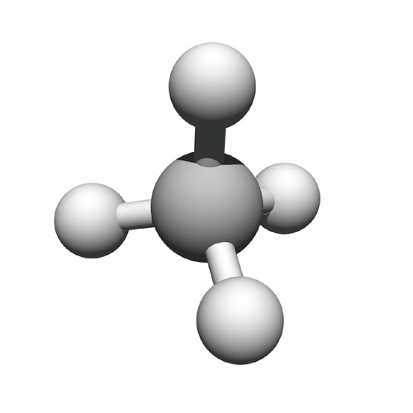
Chapter 2 Chemical Principles
Bonding
Covalent bonding

Slide 22
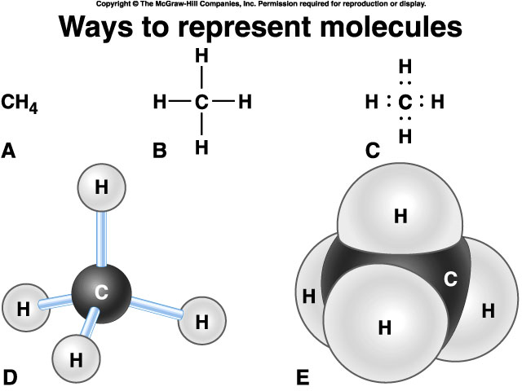
Chapter 2 Chemical Principles
Bonding
Covalent bonding

Slide 23
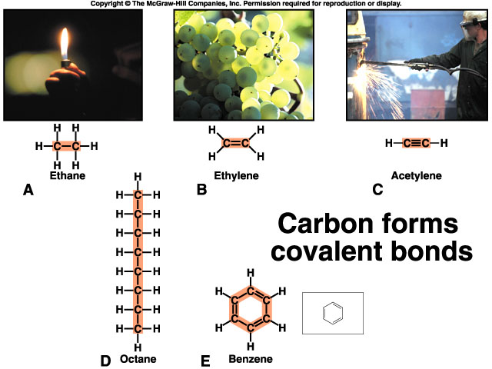
Chapter 2 Chemical Principles
Bonding
Covalent bonding

Slide 24
Chapter 2 Chemical Principles
Bonding
Covalent bonding
Polar covalent bond – unequal sharing of electrons
A great example of a molecule with polar covalent bonds is water. Why is water considered polar?
What is a partial positive and partial negative charge?

Slide 25
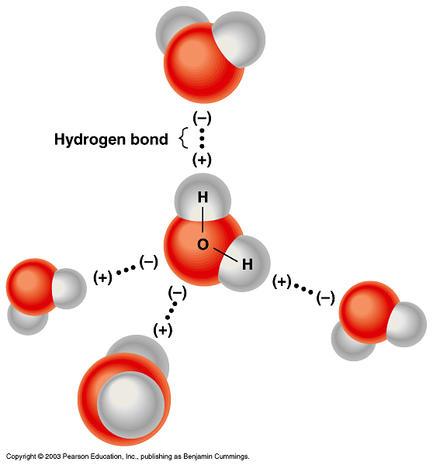
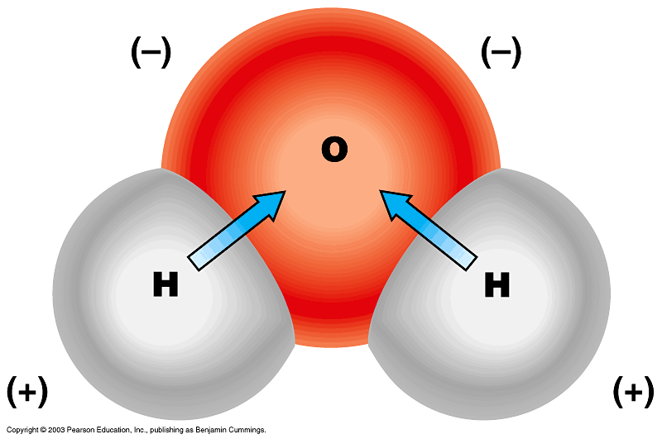
Chapter 2 Chemical Principles
Bonding
Covalent bonding
Polar covalent bond

Slide 26
Chapter 2 Chemical Principles
Bonding
Isomers
These are molecules with the same number and type of atoms but with different orientations in space.
Examples: Dill and Mint

Slide 27
Chapter 2 Chemical Principles
Bonding
Covalent bonding
Polar covalent bond

Slide 28
Chapter 2 Chemical Principles
Properties of Water
Water
Water is the solvent of Life!
Solute – substance dissolved in a solvent to form a solution
Solvent – fluid that dissolves solutes

Slide 29
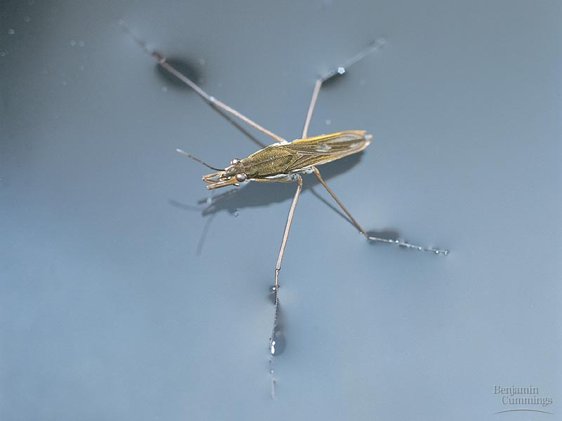
Chapter 2 Chemical Principles
Properties of Water
Water
Hydrogen bonds make water cohesive and give water surface tension. You can experience surface tension when you do your dishes.

Slide 30
Chapter 2 Chemical Principles
Properties of Water
Water
Because water has both adhesive and cohesive properties, capillary action is present.
Capillary action is one of the major reasons that trees and other plants can grow very tall.

Slide 31
Chapter 2 Chemical Principles
In order to raise the temperature of water, the average molecular speed has to increase.
It takes much more energy to raise the temperature of water compared to other solvents because hydrogen bonds hold the water molecules together!
Water has a high heat capacity.
Properties of Water
Water
Water is cooling!
Do I look cool?

Slide 32
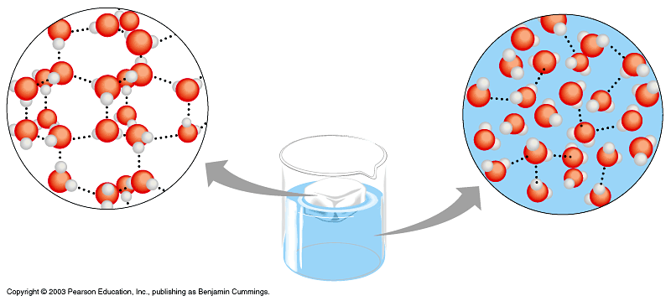
Chapter 2 Chemical Principles
Properties of Water
Water
Water is less dense as a solid! This is because the hydrogen bonds are stable in ice – each molecule of water is bound to four of it’s neighbors.

Slide 33
Chapter 2 Chemical Principles
Properties of Water
Water
So can you name all of the properties of water?
Adhesion
Cohesion
capillary action
high surface tension
holds heat to regulate temperature (High heat capacity)
less dense as a solid than a liquid

Slide 34
Chapter 2 Chemical Principles
Acids and Bases
Strength compared using pH scale
Ranges from 0 – 14
Logarithmic Scale
Acid – donates H+ to the solution
Ranges from pH 0-6.9
Base – removes H+ from the solution by donating OH-
Ranges from pH 7.1 – 14
Distilled water is pH 7.0 or neutral. Why?
H₂O H+ + OH-

Slide 35
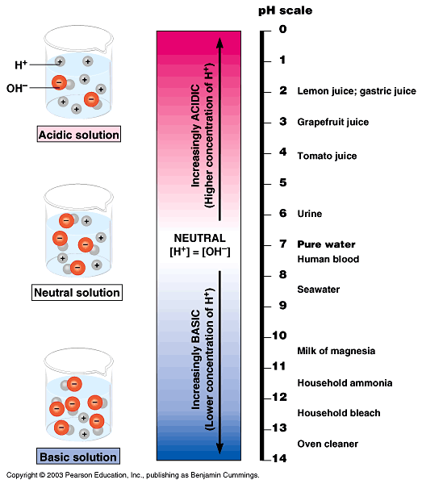
Chapter 2 Chemical Principles

Slide 36
Chapter 2 Chemical Principles
Acids and Bases
Buffers – compounds used to maintain a contant pH within a system
H₂CO₃ H⁺ + HCO₃⁻
Carbonic acid bicarbonate ion

Slide 37
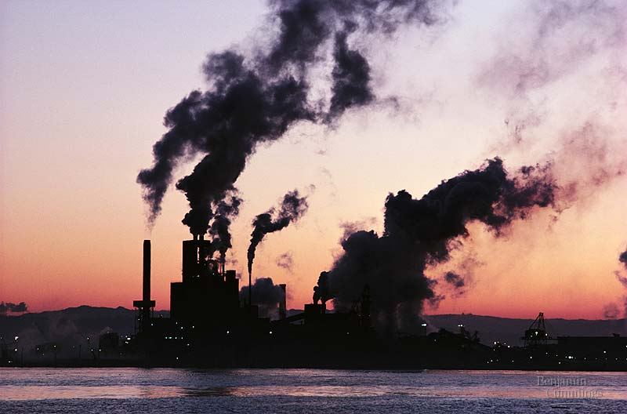
Chapter 2 Chemical Principles
Acids and Bases

Slide 38
Chapter 2 Chemical Principles
Making Molecules
and H₂O
Dehydration synthesis
H₂O
Hydrolysis

