Slide 1
Chemical Reactions
Ms. Duncan
Biology 1

Slide 2
Chemical Reactions
Chemistry is not only what life is – but what life does
Everything that happens in an organism – it’s growth, interaction with the environment, its reproduction, and even movement – is based on chemical reactions!

Slide 3
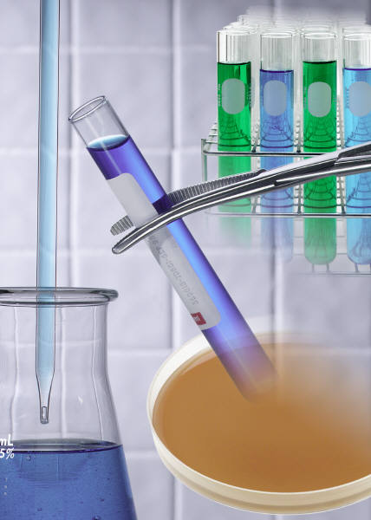
Chemical Reactions
A chemical reaction is a process that changes, or transforms, one set of chemicals into another
May occur quick or slow
Mass and energy are conserved
Chemical reactions always involve changes in the chemical bonds

Slide 4
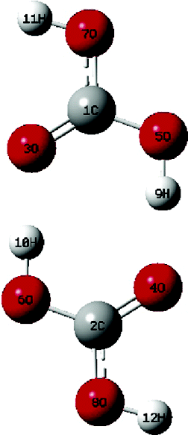
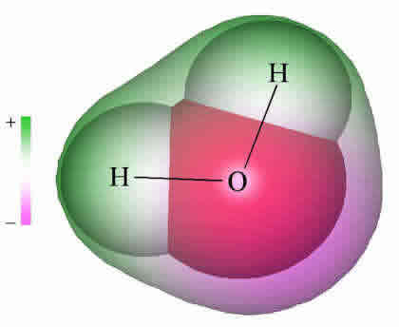
Chemical Equations
CO₂ + H₂O → H₂CO₃
Reactants
Products
+

Slide 5
Energy in Reactions
Endothermic Reactions
Absorb energy
Must have a source of energy to occur
Exothermic Reactions
Release energy – heat, light, or sound
Often occurs spontaneously

