Slide 1
Energy and Life
Biology 1
Ms. Duncan

Slide 2
Vocabulary
(KIM chart)
Autotroph
Heterotroph
ATP
Photosynthesis

Slide 3
Energy is…..
The ability to do work

Slide 4
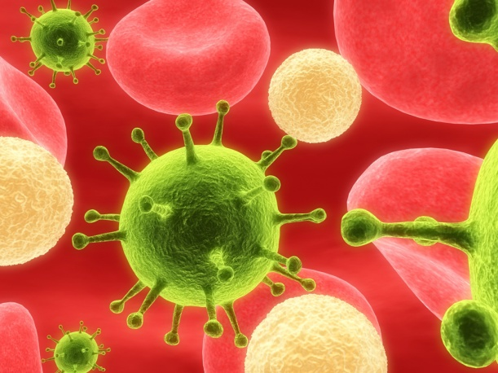
Organisms can be classified by how they get their energy
Autotrophic
Heterotrophic

Slide 5

Autotrophs
Make their own food
Sun is the energy source
Producers

Slide 6
Heterotrophs
Energy from foods consumed
Consumers

Slide 7
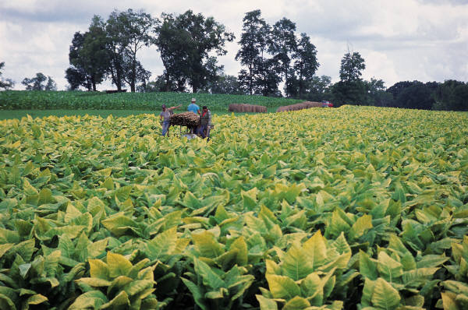
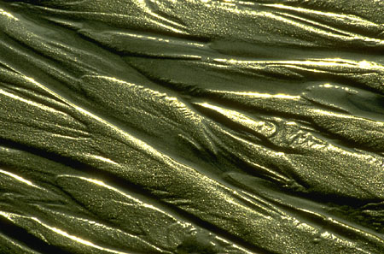
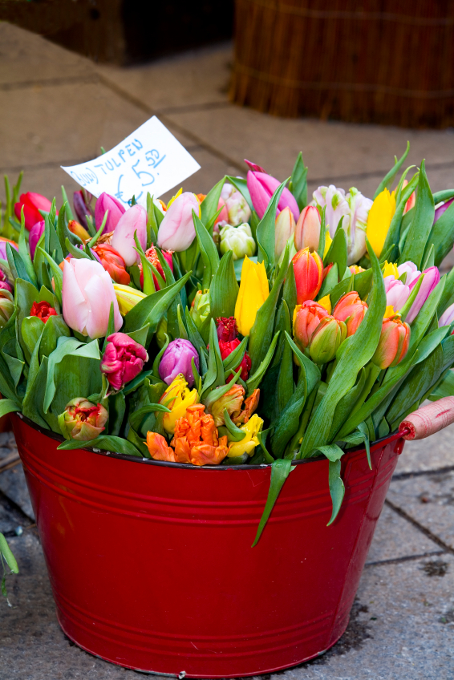
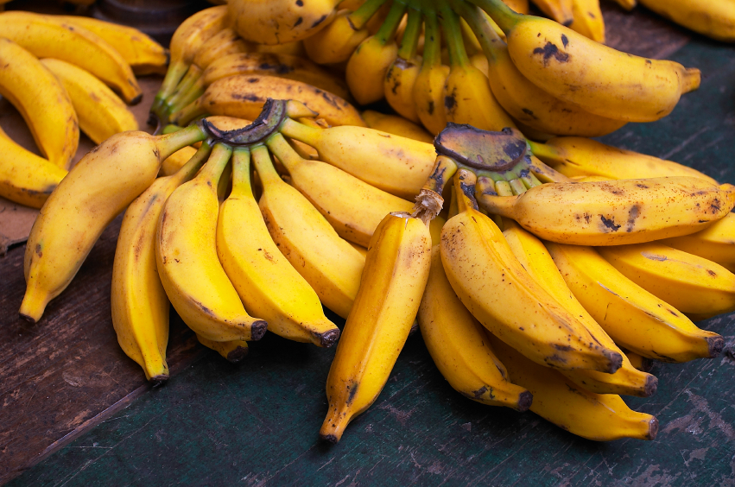
Producers

Slide 8
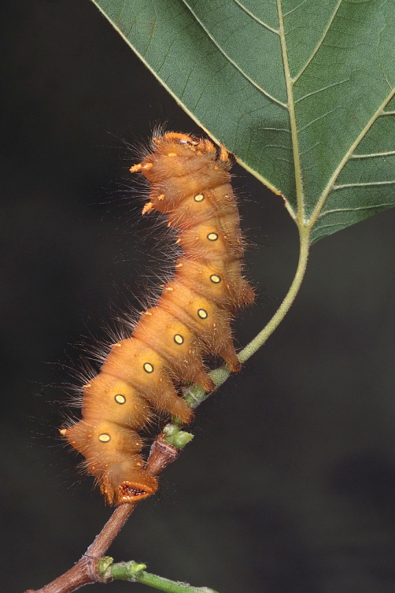
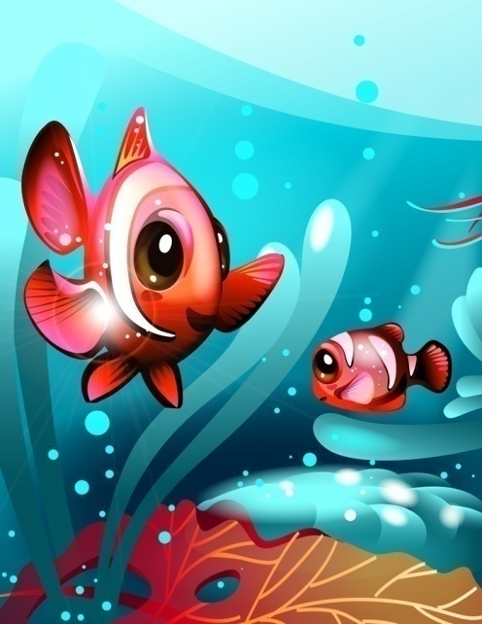
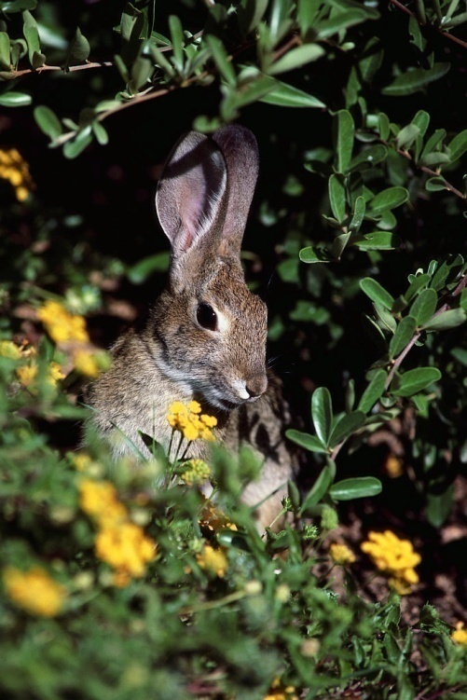
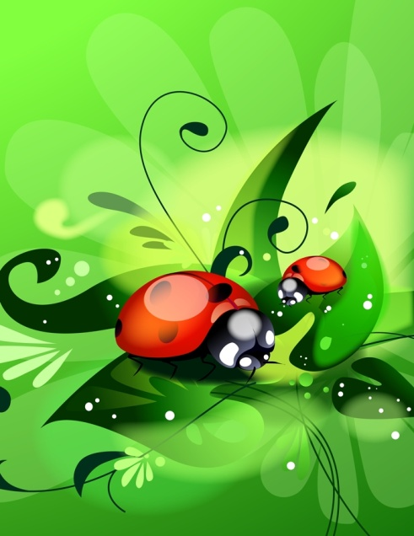
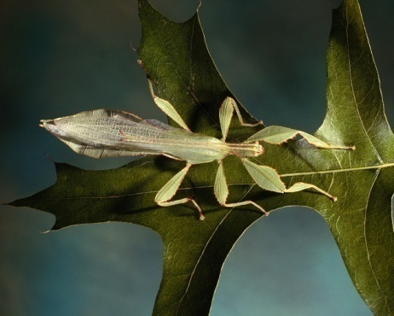
Primary Consumers
Consume producers

Slide 9


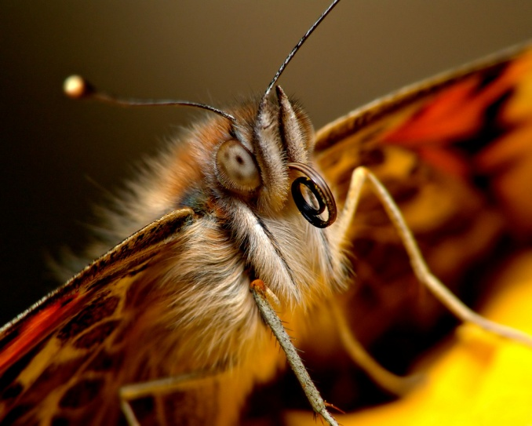
Secondary Consumers
Obtain energy from small consumers

Slide 10
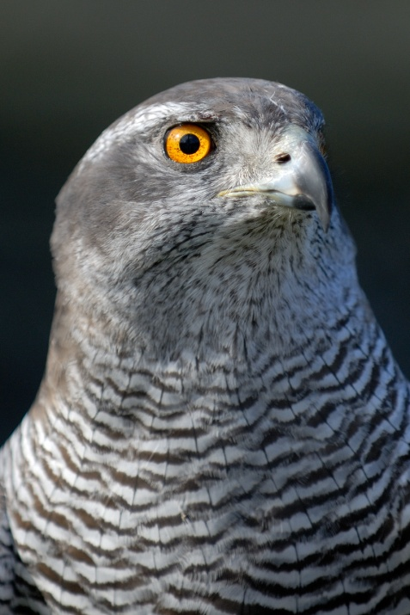
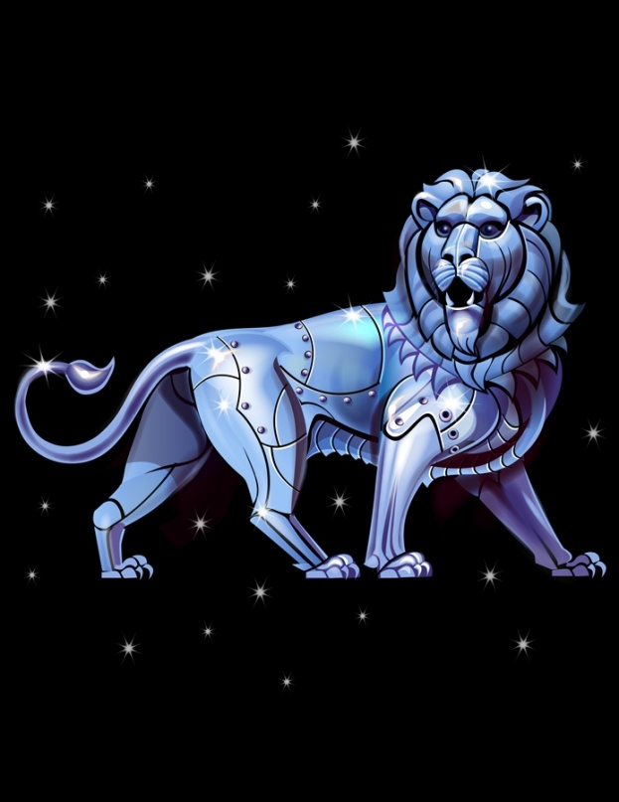
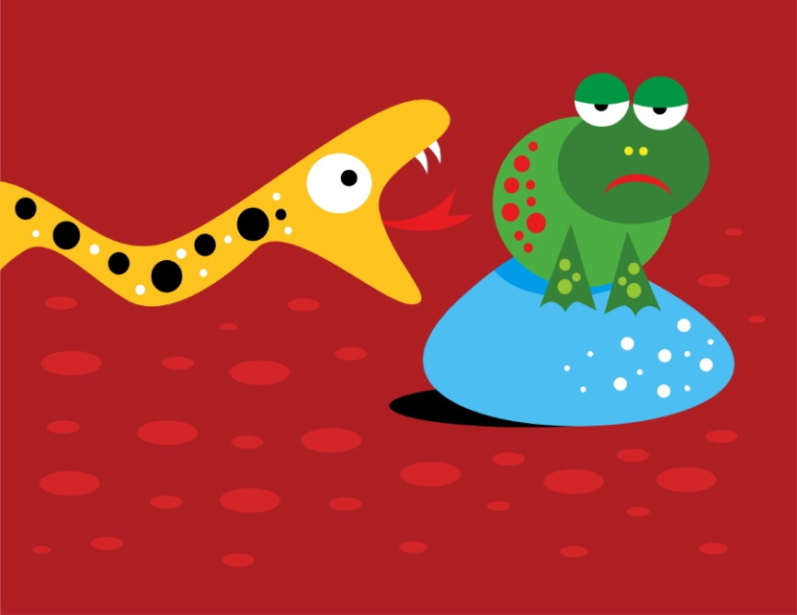
Tertiary Consumers
Obtain energy from other consumers

Slide 11

Quaternary Consumers
Obtain energy from other consumers

Slide 12
Energy Levels
Quaternary consumers
Tertiery consumers
Flow of Energy
Secondary consumers
Primary consumers
Producers

Slide 13
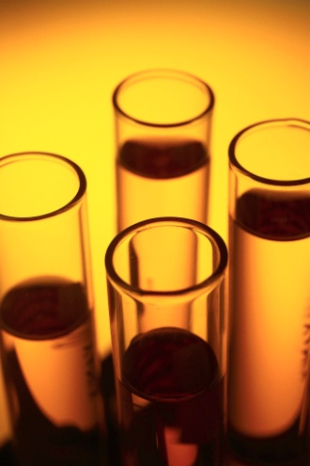

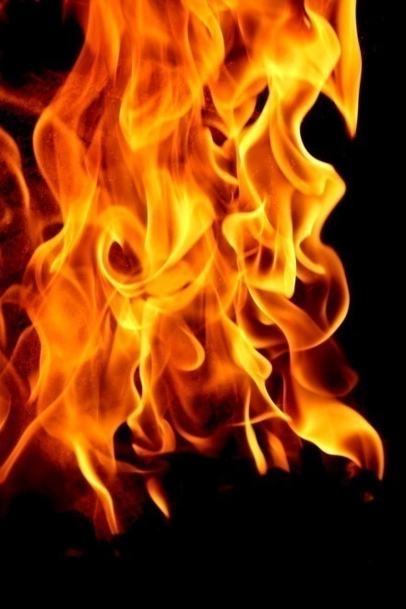
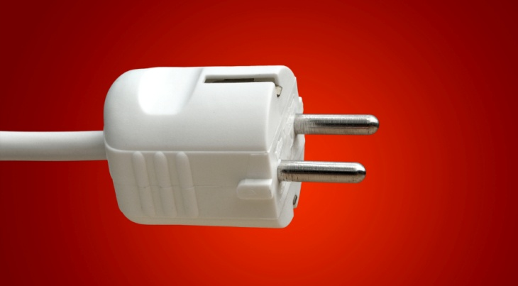
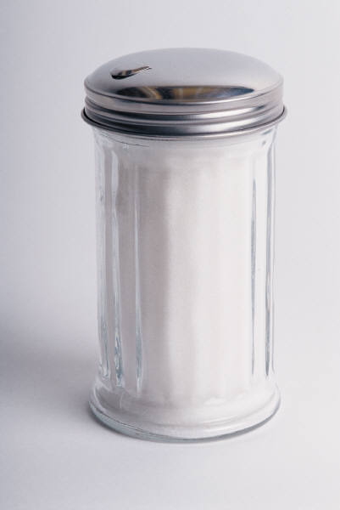
Forms of Energy
Light
Heat
Electricity
Chemicals

Slide 14
ATP
    Adenosine triphosphate, ATP, is an important chemical compound that cells use to store and release energy
    ATP is used by all types of cells as their basic energy source.

Slide 15
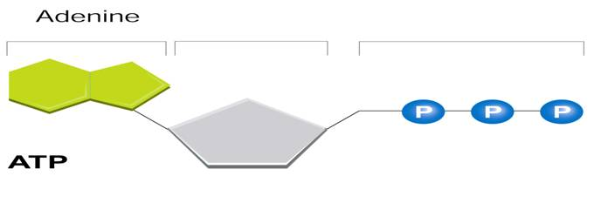
ATP
Adenine
Ribose
3 phosphate groups

Slide 16
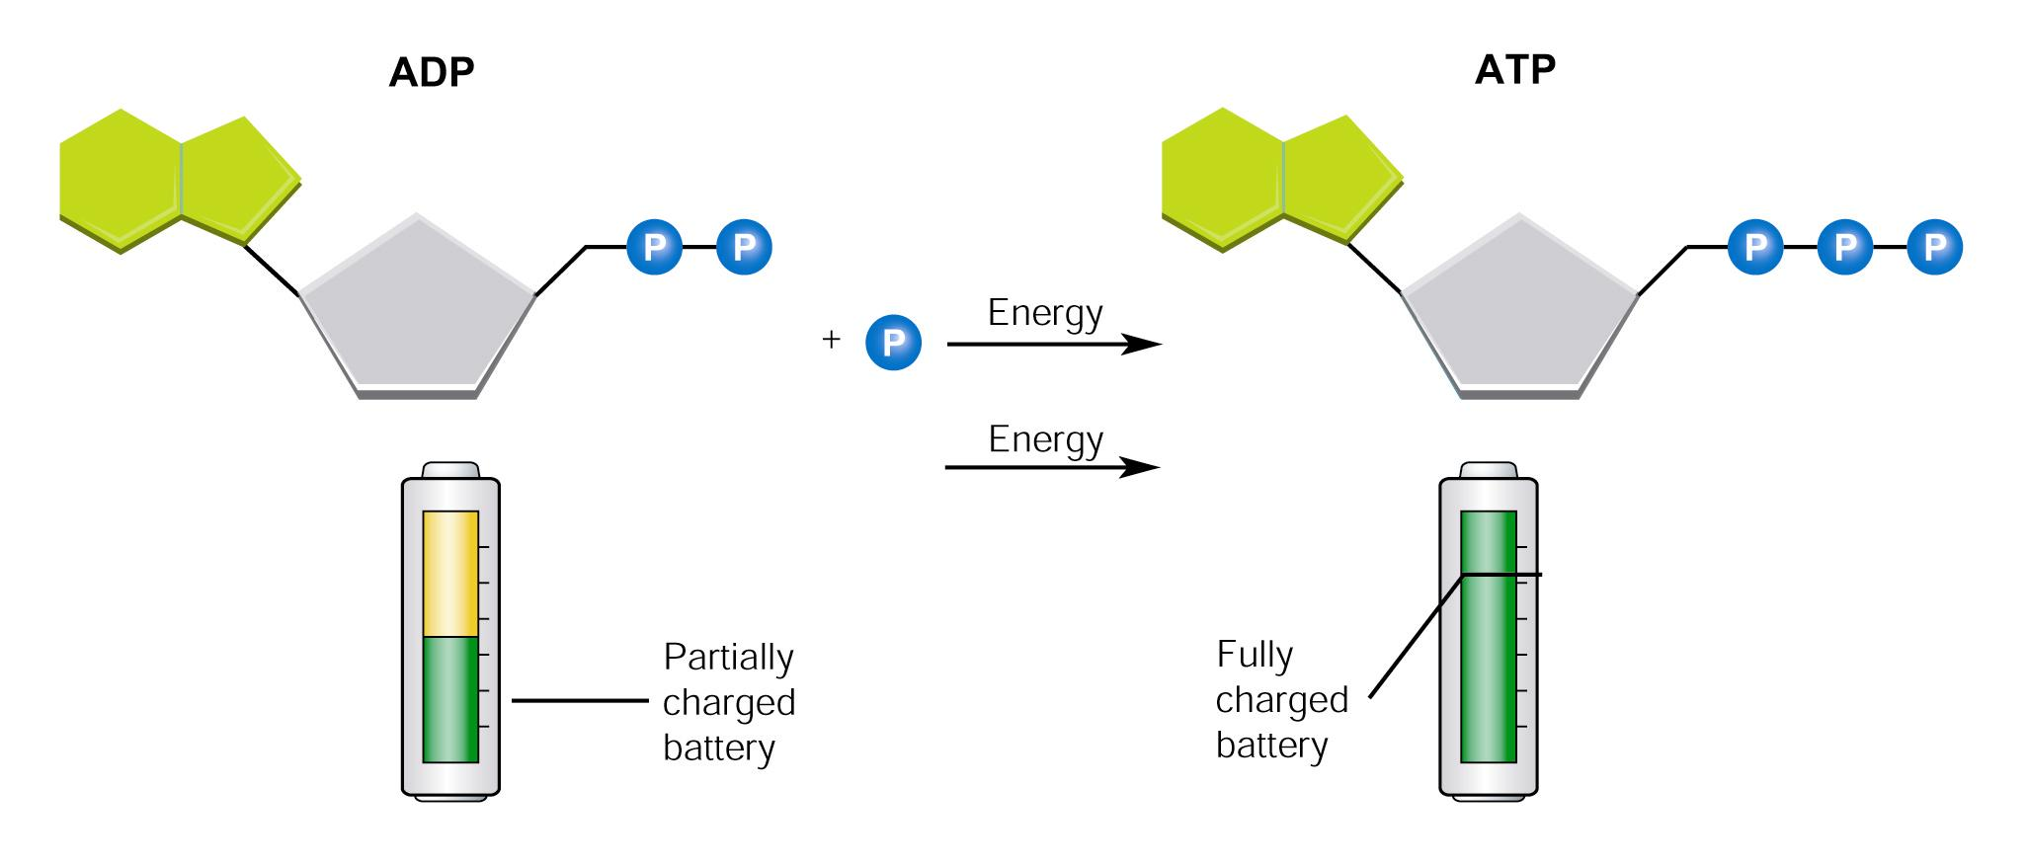
ADP
ADP only has 2 phosphate groups

Slide 17
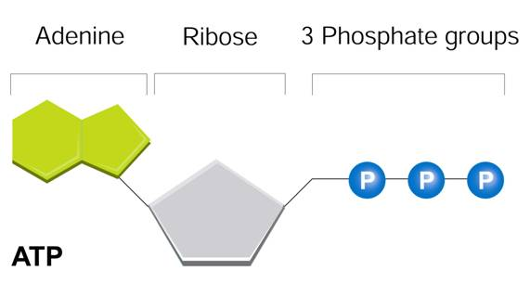

Releasing Energy
Energy stored in ATP is released by breaking the bonds between the 2nd and 3rd phosphate groups
2 Phosphate groups

Slide 18
Using Biochemical Energy
Most cells have only a small amount of ATP, because it is not a good way to store large amounts of energy.
Cells can regenerate ATP from ADP as needed by using the energy in foods like glucose.

Slide 19
#1
  Organisms that make their own food are called
    autotrophs.
    heterotrophs.
    decomposers.
    consumers.

Slide 20
#2
  Most autotrophs obtain their energy from
    chemicals in the environment.
    sunlight.
    carbon dioxide in the air.
    other producers.

Slide 21
#3
  How is energy released from ATP?
    A phosphate is added.
    An adenine is added.
    A phosphate is removed.
    A ribose is removed.

Slide 22
#4
  How is it possible for most cells to function with only a small amount of ATP?
    Cells do not require ATP for energy.
    ATP can be quickly regenerated from ADP and P.
    Cells use very small amounts of energy.
    ATP stores large amounts of energy.

Slide 23
#5
  Compared to the energy stored in a molecule of glucose, ATP stores
    much more energy.
    much less energy.
    about the same amount of energy.
    more energy sometimes and less at others.

