Slide 1
Enzymes

Slide 2
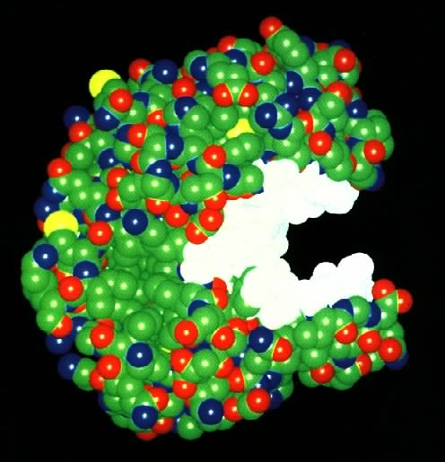
What Are Enzymes?
Most enzymes are Proteins (tertiary and quaternary structures)
Act as a Catalyst to accelerate a reaction
Click for video

Slide 3
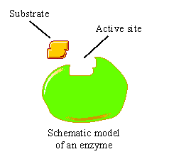
Enzymes
Are specific for what they will catalyze
Are Reusable
End in –ase
-Sucrase
-Lactase
-Maltase
Click for animation

Slide 4
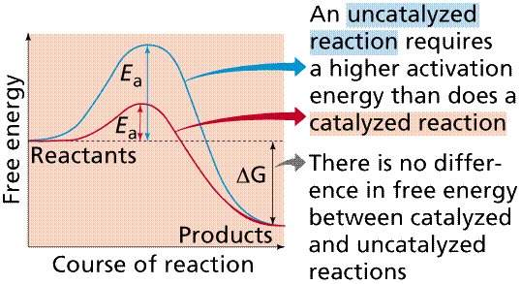
How do enzymes Work?
Enzymes work by weakening bonds which lowers activation energy

Slide 5
Enzymes
Without Enzyme
With Enzyme
Free
Energy
Free energy of activation
Reactants
Products
Progress of the reaction

Slide 7
Enzyme-Substrate Complex
The substance (reactant) an enzyme acts on is the substrate
Substrate
Joins
Enzyme

Slide 8
Active Site
A restricted region of an enzyme molecule which binds to the substrate.
Active Site
Substrate
Enzyme

Slide 9
What Affects Enzyme Activity?
Three factors:
1. Environmental Conditions
2. Cofactors and Coenzymes
3. Enzyme Inhibitors

Slide 10
1. Environmental Conditions
1. Extreme Temperature are the most dangerous
- high temps may denature (unfold) the enzyme.
2. pH (most like 6 - 8 pH near neutral)
3. Ionic concentration (salt ions)

Slide 11
2. Cofactors and Coenzymes
Inorganic substances (zinc, iron) and vitamins (respectively) are sometimes needed for proper enzymatic activity.
Example:
Iron must be present in the quaternary structure – Ex. hemoglobin in order for it to pick up oxygen.

Slide 12
Two examples of Enzyme Inhibitors
a. Competitive inhibitors: are chemicals that resemble an enzyme’s normal substrate and compete with it for the active site.
Substrate
Enzyme
Competitive inhibitor

Slide 13
Inhibitors
b. Noncompetitive inhibitors:
Inhibitors that do not enter the active site, but bind to another part of the enzyme causing the enzyme to change its shape, which in turn alters the active site.
Substrate
Noncompetitive
Inhibitor
Enzyme
active site
altered

Slide 14
Create an Enzyme foldable
Fold your paper into a hamburger.
Fold in half, and then half again
Open up and fold each side to the center fold
Cut along the center fold on each side

Slide 15
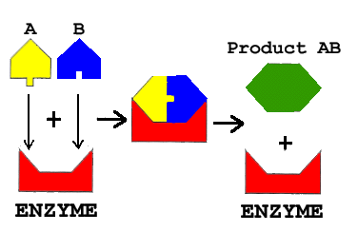
Enzyme foldable
SUBSTRATES
ENZYME-SUBSTRATE COMPLEX
On the FRONT of each tab, draw and color the 4 general steps of enzyme activity using the sketch below. Color the enzyme RED, substrate A – YELLOW, substrate B – BLUE, and the product GREEN.
Substrates
Enzyme-substrate complex
1
3
2
4

Slide 16
Enzyme foldable
On the BACK of each tab, list the following:
Tab 1 – Meaning of enzyme, substrate, & active site
Tab 3 – Factors that affect enzyme action (3 to 4 factors)
Tab 4 – Examples of biological enzymes (3 to 4 examples)

Slide 17
Enzyme Foldable
On the CENTER FOLD, write ENZYME CHARACTERISTICS and then bullet each of these answers:
Reusable or NOT reusable
Specific or NOT specific
Effect on chemical bonds
Effect on activation energy
Ending?

