Slide 1
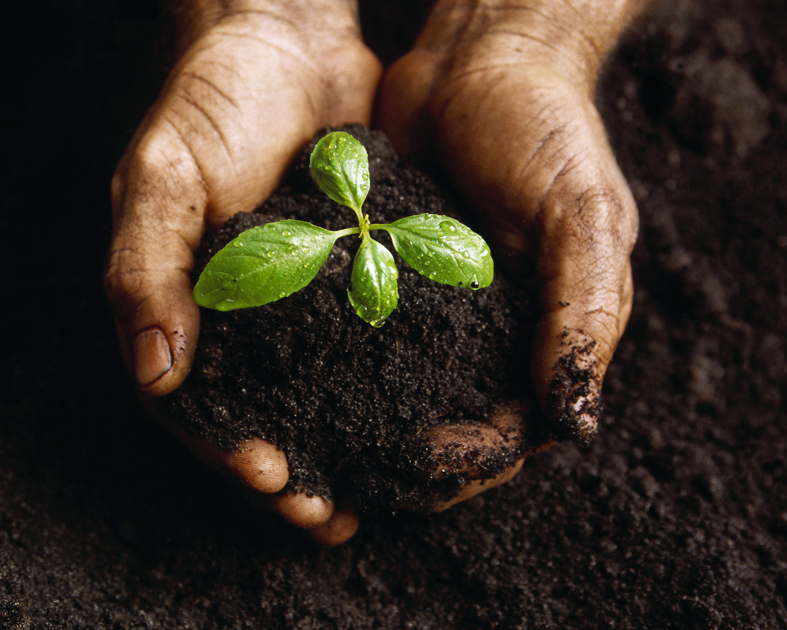
The Reactions of Photosynthesis
Notes:
To insert this slide into your presentation
Save this template as a presentation (.ppt file) on your computer.
Open the presentation that will contain the image slide.
On the Slides tab, place your insertion point after the slide that will precede the image slide. (Make sure you don't select a slide. Your insertion point should be between the slides.)
On the Insert menu, click Slides from Files.
In the Slide Finder dialog box, click the Find Presentation tab.
Click Browse, locate and select the presentation that contains the image slide, and then click Open.
In the Slides from Files dialog box, select the image slide.
Select the Keep source formatting check box. If you do not select this check box, the copied slide will inherit the design of the slide that precedes it in the presentation.
Click Insert.
Click Close.

Slide 2
Vocabulary (KIM chart)
Light Reaction
Dark Reaction (Calvin Cycle)
Chemioosmosis
Photosystem
Primary electron acceptor
NADP+
Electron Transport Chain
Carbon Fixation
C4 Pathway
CAM Pathway
FAD+
NADPH
FADH
ATP Synthase

Slide 3
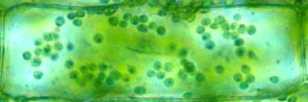
Chloroplast

Slide 4
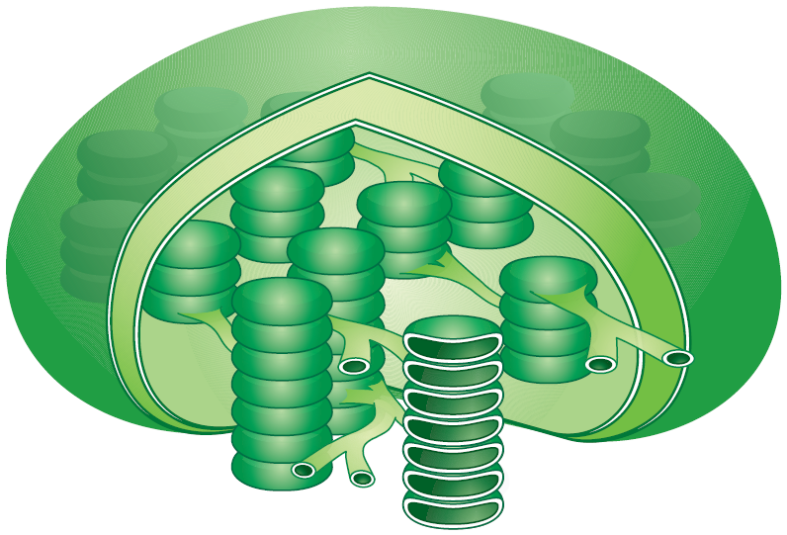
Thylakoids
Chloroplasts contain thylakoids—saclike photosynthetic membranes.
single thylakoid

Slide 5
Granum
Grana – stacks of thylakoids (Granum – 1 stack of thylakoids)
Lumella – connect the grana
Granum

Slide 6
Stroma
stroma – the space between the grana
stroma

Slide 7
Photosystems
consists of proteins that organize chlorophyll and pigments to collect light.
Photosystems

Slide 8
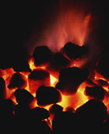
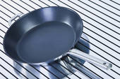
Electron Carriers
Example: NADP+
Special proteins that carry excited electrons (trapped energy from light in chemical form)

Slide 9
Light-Dependent Reactions
Occur in the thylakoid membranes
Use energy from sunlight and water to produce ATP, NADPH, and oxygen

Slide 10
Photosystem II
a.
b.
c.
Photosystem I
d.
e.
f.
g.

Slide 11
Calvin Cycle
Also called light INdependent reactions, or dark reactions (not really called that any more)
Occurs in the stroma
Uses ATP and NADPH and CO₂ to produce high-energy sugars

Slide 12
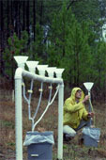
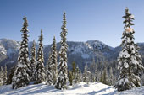
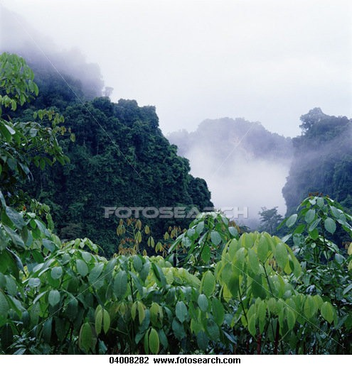
Factors affecting photosynthesis?
Amount of water
Temperature
Intensity of light

Slide 13
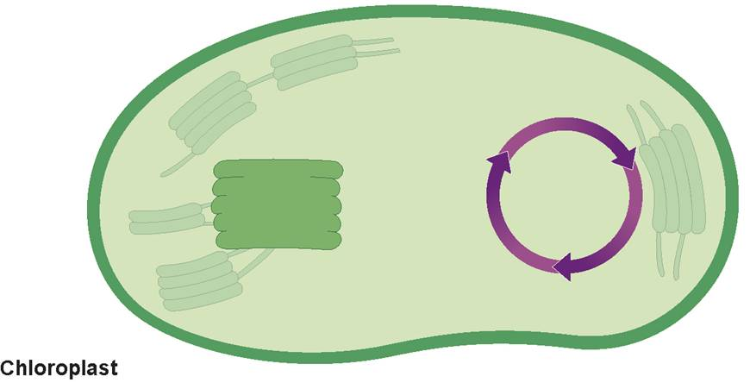
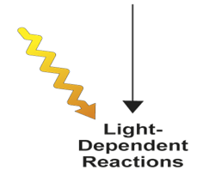
H₂O
CO₂
Light
NADP⁺
ADP + P
Light- dependent reactions
Calvin cycle
Calvin Cycle
Chloroplast
O₂
O₂
Sugars
Notes:
The process of photosynthesis includes the light-dependent reactions as well as the Calvin cycle.

Slide 14
8-3
In In plants, photosynthesis takes place inside the
thylakoids.
chloroplasts.
photosystems.
chlorophyll.

Slide 15
8-3
Energy to make ATP in the chloroplast comes most directly from
hydrogen ions flowing through an enzyme in the thylakoid membrane.
transfer of a phosphate from ADP.
electrons moving through the electron transport chain.
electrons transferred directly from NADPH.

Slide 16
8-3
NADPH is produced in light-dependent reactions and carries energy in the form of
ATP.
high-energy electrons.
low-energy electrons.
ADP.

Slide 17
8-3
Which of the following factors does NOT directly affect photosynthesis?
wind
water supply
temperature
light intensity

Slide 18
8-3
What is another name for the Calvin cycle?
light-dependent reactions
light-independent reactions
electron transport chain
photosynthesis

